Slide 1
How to Use this Resource
NASTAD originally used a version of this presentation for a three-part webinar series for the Texas State Department of Health and Human Services in 2021. This slide set and the notes on each slide are intended for health department staff to use as a template to present foundational cluster detection and response (CDR) information to community partners and health department staff, either in-person or virtually. Certain slides in this deck that were originally populated with state-specific information are watermarked with “EXAMPLE” to emphasize they are templates/sample slides. Other slides (including the example slides) have bolded text in the notes section with suggestions for modifications the presenting health department(s) should make to customize the content based on jurisdiction-specific information. Slides, their accompanying notes, and slide animations may be adapted based on factors including the audience, details of the jurisdiction's CDR work, and state/local policies. We recommend consulting your health department’s legal counsel for expertise and assistance with the section on state HIV criminalization laws. If you have any questions about these slides, the original webinar series, or holding your own health department-led learning series, please contact Erin Bascom at ebascom@nastad.org.

Slide 2

LEARNING SERIES
HIV Cluster Response
Public Health Surveillance Basics &
Using Surveillance Data to DETECT HIV Clusters
PART 1
Notes:
Hello everyone, and welcome to Part 1 of the Learning Series: HIV Cluster Response Public Health Surveillance Basics & Using Surveillance Data to Detect HIV Clusters.

Slide 3
Introductions and Initial Questions
Please rename yourself on zoom to include your role at your health department, CBO, or in the community, and your role in CDR planning (if applicable)
Go to menti.com and enter the code on the screen
Prompt: "What initial questions or concerns about CDR do you have?"
All answers are anonymous
Notes:
To start us off, we’re going to jump into introductions and initial questions.
First, we ask that you [read first bullet]
That way, if or when you’re speaking, folks have an idea of your background.
*pull up menti to share screen*
When you’re done doing that, you can go to menti.com (we recommend that you do so on your phone or different tab) and enter the code on the screen momentarily. We want to see what initial questions and concerns you are coming in with today. The menti website should now be prompting you to enter your questions or concerns, and again, this screen will start populating with your responses that people submit. [make observations about what is coming up on the screen] Some of these questions will hopefully be answered or explored by the end of today’s webinar, and most of them by the end of this series. We will make sure to keep these results so we can discuss things that haven’t been covered at the end of day three.

Slide 4

Expectations and Logistics
[VIRTUAL]
Participation
Participants will be muted to limit background noise, but you may unmute yourself during discussion or Q&A if you want to talk
Will have some interactive components during the webinar
Asking questions
Please submit questions in the chat box and/or can ask verbal questions during Q&A times
Maintaining a safe space for discussion
For IT issues: please email: [insert contact email]
Notes:
Before we get started, I want to quickly go over expectations and logistics for today. Please stay muted while the speakers are presenting, but feel free to unmute yourself during discussion and Q+A sections if you want to speak, as there will be some interactive components during this webinar series. Please introduce yourself with your pronouns before you make a comment or ask a question. You can also submit questions/comments in the chat box outside of designated Q+A or discussion time. Also, we know everyone comes to this series with different knowledge, experiences, and opinions, so we want to create a safe space for learning and growth together throughout these next three sessions. Lastly, if you’re having any technical issues, please email [insert contact email]

Slide 5
Learning Series
PART 1
Public Health Surveillance Basics & Using Surveillance Data to Detect HIV Clusters
PART 2
Health Department, Provider, and Community Collaboration to Respond to HIV Clusters
PART 3
Addressing Community Concerns: Data Release and HIV Criminalization Considerations & HIV Stigma
Notes:
NOTE: Insert jurisdiction-specific dates to this slide.
Today’s presentation is Part 1 of a three-part learning series. Each day is a blend of presentation slides and interactive discussion-based components. If you’re unable to attend all three days, the slides will be shared after the workshop concludes.
The series is divided into three parts, and today we will focus on the basics of public health, HIV surveillance, and detecting HIV clusters. Part 2 will focus on the HD and partner response to HIV clusters, and the roles that HDs and community/provider partners each play in this activity. Part 3 will discuss policy issues around the implementation of HIV cluster response, along with a discussion of stigma’s role in HIV cluster detection and response.

Slide 6
Three-Part Learning Series Objectives
Understand the history and concepts behind public health surveillance including ethics, consent, and data protection for HIV surveillance data
Explain the basic process, benefits, and drawbacks of HIV cluster response
Effectively communicate with community members/clients/patients about common cluster response concerns
Notes:
NOTE: Please alter these objectives based on the specific takeaways that you hope for the participants to gain.

Slide 7
Objectives for Part 1
Understand the history, goals, and basic concepts behind public health surveillance, and specifically HIV surveillance
Describe the process through which HIV surveillance data are reported to the health department and to the CDC (HIV case reporting data flow) and how the data are protected from release
Explain how HIV surveillance data are used to guide HIV prevention work and measure progress in meeting prevention goals
Understand what an HIV cluster is and how health departments use public health data to detect clusters
Notes:
NOTE: Please alter these objectives based on the specific takeaways that you hope for the participants to gain.

Slide 8


Agenda for Today
Public Health Disease Surveillance
Data Protection
Using Surveillance Data to Monitor HIV Prevention and Care Goals
Using Surveillance Data to Detect HIV Clusters
Visualizing HIV Clusters
Mentimeter: Questions and Concerns Related to Surveillance
Q&A and Wrap Up
Notes:
This is our agenda for today. [Go through each bullet] We encourage you to write down all your questions – both content and logistics-related – so we can address them all in the closing mentimeter and Q+A sections.
First up, we have [insert presenter’s name and bio]

Slide 9
Public Health
Disease Surveillance Overview
Notes:
I am going to start our discussion today by providing the context for HIV surveillance by describing disease surveillance in general

Slide 10

Disease Reporting:
State and Federal Roles
Laws and rules governing communicable disease reporting reside at the state (city/county) level
The CDC and national organizations, like CSTE*, make recommendations, not state or local laws/rules
Some data collection is required under federal funding agreements and is supported by guidance standards and technical assistance
HIV Reporting
The process of establishing a national HIV reporting system spanned 22 years
40 HIV-related CSTE Position Statements over 34 years (1986-2020)
https://www.cste.org/page/PositionStatements
*Council of State and Territorial Epidemiologists
Notes:
To provide this context, it is helpful to understand how disease reporting is structured in the United States.
To begin, Laws and rules governing communicable disease reporting reside at the state (and sometimes at the city/county) level but NOT at the national level
However, The CDC and national organizations, like the council of state and territorial epidemiologists (CSTE), make recommendations, not state or local laws/rules. This organization represents epidemiologists working at the state, local and territorial health departments and works closely with CDC to write case definitions, set standards and otherwise make disease reporting policy in this country.
While CDC cannot make laws some data collection is required under federal funding requirements
The process of establishing a national HIV reporting system spanned 22 years with 40 HIV-related CSTE Position Statements over 34 years (1986-2020).
This amount of scrutiny and attention is far greater than virtually any other notifiable infectious disease and reflects the close work CDC and the health departments have done responding to the evolving epidemic as well as community concerns over the years.

Slide 11
Public Health Surveillance: Definition
Public health surveillance is the systematic and ongoing assessment of the health of a community, including timely
Collection
Analysis
Interpretation
Dissemination and subsequent use of the data for public health purposes
Examples include notifying contacts, providing referrals to care or services
Case reporting is the most common type of disease surveillance
Population-based
Not research
Not a consent-based process
Based on:
Teutsch, SM and Churchill, RE. Principles and Practice of Public Health Surveillance. Oxford University Press 1994
Glynn KM and Backer LC . Collecting Public Health Surveillance Data, Creating a Surveillance System; Chapter 4 in Lee LM, Teutsch SM, Thacker SB and St. Louis ME. Principles and Practice of Public Health Surveillance. Oxford University Press 2010
Notes:
The definition of Public health surveillance is the systematic and ongoing assessment of the health of a community, including timely
Collection
Analysis
Interpretation
Dissemination and subsequent use of the data
I underscore use of the data because it is what differentiates disease surveillance from research
Case reporting is the most common type of disease surveillance although the terms are often used interchangeably
PH surveillance is Population-based and it is
Not research, which exempts it from IRB review, and it is
Not a consent-based process
Let’s talk about what population-based means for a minute. When I say population-based it means that the data include everyone, not a sample. Knowing the level of disease in the whole population is vital to planning prevention and care programs.
To use a budget analogy, consider how you could prioritize household or organizational spending if your budget only included some of your income.
Population based data includes everyone so that the data are complete and can be used to plan prevention programs and care services and capture rare events. And, some disease surveillance systems, such as HIV, also serve the purpose of reaching out to individuals, underscoring the need to include the whole population.
For a brief but interesting history of surveillance systems in general and how surveillance started in the US I refer you to the textbooks listed on this slide

Slide 12
Disease Surveillance: Consent
Disease surveillance, by necessity occurs without explicit consent
Describes disease patterns in the population
Used to prevent and control transmission
Examples and how the information is used:
Food borne illness such as Salmonella
To stop transmission, need to identify source
Respiratory spread such as TB or COVID-19
Notify contacts for treatment or quarantine
Bodily fluid but non-respiratory spread such as HIV
Facilitate linkage to, engagement in care
Notify contacts and those at risk of infection, offer PrEP
Follow up on clusters and interrupt transmission
Ethical Justification for Conducting Public Health Surveillance Without Patient Consent
Notes:
Let’s spend a minute on the consent issue which I mentioned on the previous slide where I said that
Disease surveillance by necessity occurs without explicit consent and is used to
Describe disease patterns in the whole population
Used to prevent and control transmission
It isn’t consent based because of how vital the information is for public health to act and prevent disease transmission.
Let’s review some other disease Examples and how the information is used
For a Food borne illness such as Salmonella that carries less stigma than HIV
The information on reported cases is used to identify the source so we can stop transmission
Consider, for example, how difficult it would be to stop an outbreak of a foodborne illness if people had to consent to having a salmonella infection reported.
For diseases spread by the Respiratory route such as TB, (or COVID-19)
The goal is to Notify contacts for treatment or quarantine as well as use the data to inform disease control efforts
For diseases spread by Bodily fluids (but that are not spread by the respiratory route) such as HIV we use the information to
Facilitate linkage to, and engagement in, care
As well as to Notify contacts and those at risk of infection, and to offer pre-exposure prophylaxis or PrEP to prevent others from becoming infected as well as to
Follow up on clusters and interrupt transmission
A notable example of how the HIV surveillance data are used is that they form the basis of the formula used to disseminate Ryan White dollars for care of persons living with HIV. Nationally, during FY 2020, that was 2 billion, 388 million, 781 thousand dollars (including supplemental awards). $2,388,781,000
During that same year [State] received $____for just their Part B award.
https://hab.hrsa.gov/program-grants-management/ryan-white-hivaids-program-funding
For reference only:
For those of you who may not be familiar with PrEP, it’s an acronym for Pre-exposure prophylaxis and is a way for people who do not have HIV but who are at very high risk of getting HIV to prevent infection by taking a pill every day. When someone is exposed to HIV through sex or injection drug use, the medicines in PrEP can work to keep the virus from establishing a permanent infection.

Slide 13
Non-Communicable and
Communicable Diseases
Notes:
The illnesses on the next two slides are both required to be reported to health departments for public health action and are examples of disease surveillance data to help put HIV surveillance into context.
After these two slides I will discuss how HIV surveillance works, ethical considerations and data protection.

Slide 14
Non-Communicable
CANCER
Monitor cancer trends over time
Prevent disease
Guide planning and evaluations of cancer control programs
Advance clinical, epidemiologic, and health services research
Examples of Using Surveillance Data for Public Health Action
LEAD POISONING
Identify children with elevated blood levels, link to treatment
Identify locations
Remove source of lead
Notes:
This slide has examples of non-communicable diseases or conditions;
Cancer surveillance data are used to:
Monitor cancer trends over time,
Prevent disease,
Guide planning and evaluations of cancer control programs,
Advance clinical, epidemiologic, and health services research
Lead poisoning is a classic example of a non-communicable and non-infectious condition. Interestingly, in 1995 elevated blood lead levels became the first non-infectious condition to be reportable on a national level
The information is used to:
Identify children with elevated blood levels, and link them to treatment
Identify locations with high levels of lead
Remove the source of the lead
Again, note the emphasis on using the data for public health action
These two examples do not involve identifying and treating contacts of the person with the infection or condition
(https://www.cdc.gov/nceh/lead/data/index.htm)

Slide 15
Communicable Diseases
Examples of Using Surveillance Data for Public Health Action
TUBERCULOSIS
Link persons to care and monitor treatment (“D.O.T.”)
Identify those potentially exposed and test contacts
SYPHILIS
Provide treatment
Identify sexual partners of cases, test and provide treatment as warranted
Notes:
In contrast to the previous slide, Communicable diseases are illnesses caused by viruses or bacteria that people spread to one another through contact with bodily fluids, blood products, or through the air, (https://www.ncbi.nlm.nih.gov/books/NBK470303/)
Think of the root of the word being communicated– it implies between people. They are a type of infectious disease, caused by an infectious agent such as bacteria, viruses, fungi or parasites. Not all infectious diseases are passed directly between people; for example, they may be picked up from food, insects or animals.
These two are communicable and the information collected is used to identify, test and treat contacts.
For Tuberculosis
we Link persons to care and monitor treatment (it’s called directly observed therapy or “D.O.T.”) and
Identify those persons potentially exposed and test contacts
For Syphilis
we Provide treatment that cures the infection, and
Identify sexual partners of cases, test and provide treatment as warranted
HIV is communicable but the stigma associated with it makes standard public health practices more difficult. While working to decrease stigma and criminalization we still use what we know to help keep people living with HIV healthy and prevent further transmission. We will be discussing stigma and criminalization in Part 3 of this series
~~~~~~~~~~~~~~~~~
[For reference- not to read] Infectious diseases are disorders caused by organisms — such as bacteria, viruses, fungi or parasites. Many organisms live in and on our bodies. They're normally harmless or even helpful. But under certain conditions, some organisms may cause disease. Some infectious diseases can be passed from person to person. (https://www.mayoclinic.org/diseases-conditions/infectious-diseases/symptoms-causes/syc-20351173) and are therefore communicable

Slide 16
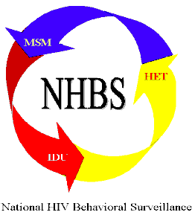
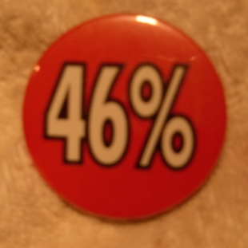


Surveillance = Information for Action
1.
Data Collected & Analyzed
2.
Data
Disseminated
3.
Public Awareness
And Activism
4.
Public Health
Response
5.
Progress towards Strategic Plan goals
Reduce the number of new HIV infections by 25% by 2015
focusing on eliminating racial and ethnic disparities…
Many Men, Many Voices (3MV)
Notes:
As an example of how we are using surveillance as information for action,
<CLICK>
this slide shows how the National HIV Behavioral Surveillance system has been used in this way.
First, the data that are gathered are specifically geared toward answering questions that can be immediately beneficial to prevention activities. This means that we collect data for a very specific purpose and want to ensure that our questionnaire asks targeted questions to ensure that only the most essential, critical topics are being asked of participants.
Next
<CLICK>
the NHBS data are analyzed and disseminated in reports like the morbidity and mortality weekly report (MMWR), which, in this example, then brought attention to a specific issue, that is, a crisis among African American men who have sex with men or MSM;
<CLICK>
An early round of NHBS found that only 46% of black MSM knew their HIV status and
<CLICK>
these data were used to support the rationale for instituting a national response to the epidemic in black men who have sex with men and designing prevention programs
<CLICK>
such as many men, many voices.
<CLICK>
The purpose is to make progress on the goals in our strategic plan such as reducing the # of new HIV infections and focusing on eliminating racial and ethnic disparities

Slide 17
HIV Case Reporting Data Flow
Local
(City, County)
Health Department
PLWH
WHO?
Private/Public
Medical Providers
Hospitals
Clinics
HIV Testing sites
Laboratories
CDC reports
City, County, State Reports
Websites, Slides, Infographics, News stories
Name
Address
Zip Code
Active Case Finding
WHAT?
HIV tests
Viral Load
CD4 counts
Genotypes
State Health Department
Name
Address
Zip Code
https://www.cdc.gov/publichealthgateway/sitesgovernance/index.html
Notes:
Now I am going to discuss the flow of data in the HIV case reporting process to give you a feel for how it works
<CLICK>
Starting with people living with HIV,
<CLICK>
medical providers, laboratories and others send various HIV tests (such as antibody and antigen tests like the NAAT), genotypes, viral loads and CD4 counts
<CLICK>
directly to state health departments in most states. In some states, these reports go directly to local health departments too who send it on to the state. (This depends on how the law is structured in each state- see link shared in the slide footer).
<CLICK>
the state or local health departments that receive this information do active case finding through a variety of methods, to ensure reporting is as complete as possible.
<CLICK>
those HDs send the information without name, address or zip code to CDC.
<CLICK> <CLICK>
At every level the data are used in reports, to put on websites, to make infographics for educational purposes and news stories all for the purpose of preventing further transmission and providing care.
“Molecular surveillance” for cluster detection is based on receiving genotypes, which are one type of lab test shown in the lower left-hand corner of this slide. I’ll discuss genotype reporting shortly, but first I want to touch on ethical considerations and how the data are protected.

Slide 18
PUBLIC HEALTH SURVEILLANCE:
PUBLIC HEALTH SURVEILLANCE DATA:
Used to protect, maintain, and improve the health of the public
Should be acquired and used for legitimate public health purposes
Required by CDC funding to be protected and stored securely
RECOGNIZE:
Use of public health surveillance data may conflict with individual interests because of the stigmatizing and potential legal consequences
For highly stigmatized infections, like HIV, scrupulous attention to how the data are collected, protected and used is vital to disease control efforts
If used at the individual level the reason should be to improve the health of the individual and prevent transmission (Data to Care and Cluster Detection and Response examples)
Ethical Considerations
References:
Centers for Disease Control and Prevention. Data Security and Confidentiality Guidelines for HIV, Viral Hepatitis, Sexually Transmitted Disease, and Tuberculosis Programs:
Standards to Facilitate Sharing and Use of Surveillance Data for Public Health Action. Atlanta (GA): U.S. Department of Health and Human Services, Centers for Disease Control and Prevention; 2011
Shifting the Paradigm: Using HIV Surveillance Data as a Foundation for Improving HIV Care and Preventing HIV Infection. Sweeney P, Gardner LI, Buchacz K et al. Milbank Quarterly Vol. 00, No. 0, 2013 (pp. 1–48)
Notes:
To justify collecting such personal data without consent, we must consider the ethics.
<CLICK>
Doing so means that Public health surveillance data must be:
Used to protect, maintain, and improve the health of the public
it Should be acquired and used for legitimate public health purposes and
Required by CDC funding to be protected and stored securely.
<CLICK>
Funded hepatitis, HIV, STD and TB programs must follow CDC’s data security and confidentiality guidelines. On a federal level CDC HIV data have an extra level of protection under an Assurance of Confidentiality which is a formal confidentiality protection authorized under Section 308(d) of the Public Health Service Act. It is used for projects conducted by CDC staff or contractors that involve the collection or maintenance of sensitive identifiable or potentially identifiable information.
<CLICK>
We need to Recognize that:
Use of public health surveillance data may conflict with individual interests because of the stigmatizing and potential legal consequences
For highly stigmatized infections, like HIV, scrupulous attention to how the data are collected, protected and used is vital to disease control efforts
If used at the individual level, the reason should be to improve the health of the individual (for example Data to Care which uses the data to identify people who are not in care and offers them assistance with relinking to care that works for them.)
<CLICK>
A thorough review of this topic can be found in this 2013 article about the movement from using surveillance data to describe disease distribution to using it to help individuals

Slide 19

PUBLIC HEALTH SURVEILLANCE:
Implications for Persons in HIV Clusters
Names and other identifying information are not shared outside of the health department
Field staff who may contact partners do not disclose the identity of other persons in the cluster
Health departments use names to find other members of the cluster and offer help with testing, linkage to PrEP and linkage to and engagement in care
Notes:
We take these ethical considerations into account when investigating HIV clusters by
Not sharing Names and other identifying information outside of the health department <pause>
Field staff who may contact partners do not disclose the identity of other persons in the cluster
Health departments use names to find other members of the cluster and offer help with testing, linkage to pre-exposure prophylaxis or PrEP (for people who test negative) and linkage to and engagement in care (for people who test positive)- NOT to share with other members of the cluster

Slide 20
Data Protection
Notes:
Both robust data protection and community engagement are essential to minimize potential harms and maximize benefits.
We will be discussing community engagement when we meet for Part 2 as part of the presentation on responding to clusters.
Today I will discuss protecting the data from disclosure because it is an integral and pivotal part of disease surveillance upon which cluster detection and response depend.

Slide 21

PUBLIC HEALTH SURVEILLANCE:
Considerations for Use
Adequate legal and other controls for protecting privacy of health-related information and discrimination should be developed
Use of individual-level data, including for legitimate public health purposes, should incorporate input from those directly affected by such use
During design of such programs
On an ongoing basis
Notes:
Considerations for using public health (PH) Surveillance data
I want to start this discussion by saying that reliably and consistently protecting PH data from disclosure is the base upon which any effective surveillance program is built; if PH departments use the data to protect the public’s health it must be trusted to guard it; without that the system cannot collect accurate data
In order to do this:
<CLICK>
Adequate legal and other controls for protecting privacy of health-related information and discrimination should be developed
<CLICK>
Use of individual-level data, including for legitimate public health purposes, should incorporate input from those directly affected by such use
During design of such programs AND
On an ongoing basis
[insert any relevant points about data protections in the presenting jurisdiction]

Slide 22

Data Protection Requirements
Adherence to specific data protection requirements are a condition of CDC funding of HIV surveillance and prevention programs:
Data Security and Confidentiality Guidelines for HIV, Viral Hepatitis, Sexually Transmitted Disease, and Tuberculosis Programs:
Standards to Facilitate Sharing and Use of Surveillance Data for Public Health Action
https://www.cdc.gov/nchhstp/programintegration/docs/pcsidatasecurityguidelines.pdf
Notes:
Adherence to specific data protection requirements is a condition of CDC funding for HIV surveillance and prevention programs. Each HD has a data security and confidentiality manual and conducts annual training based on the CDC guidance document, called:
Data Security and Confidentiality Guidelines for HIV, Viral Hepatitis, Sexually Transmitted Disease, and Tuberculosis Programs:
Standards to Facilitate Sharing and Use of Surveillance Data for Public Health Action
[any specific points about jurisdictional-specific data protections here]

Slide 23
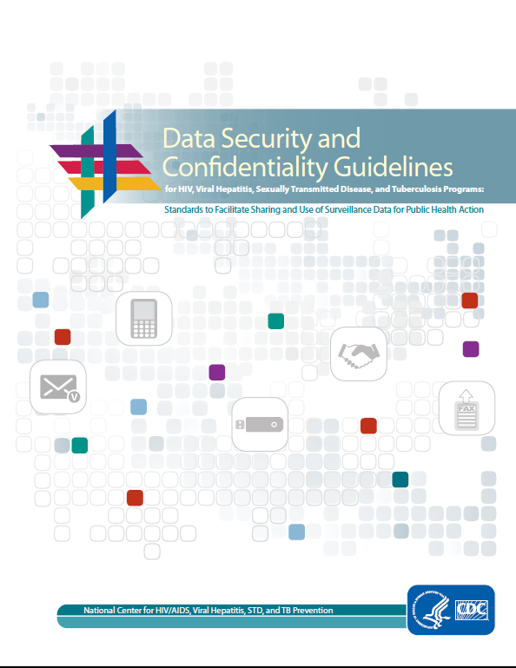
CDC Data S&C Guidelines—Standards to Facilitate Sharing and Use of Surveillance Data for Public Health Action
Notes:
These are the 2011 cross program integrated Security & Confidentiality guidelines from CDC that I just mentioned. They were the first time CDC produced guidelines across all the divisions in the National Center for HIV, Hepatitis, STD and TB Prevention and are the basis on which such policies are written, and data sharing is done, both within and outside of the health department.
The cross-program nature of this document emphasizes that the same standards apply to HIV, Viral Hepatitis, STIs, and Tuberculosis. Adhering to these standards can make sharing data for PH purposes secure. CDC monitors implementation of these guidelines and provides technical assistance and funding to implement its principles.
These guidelines are under revision with an anticipated final draft expected in early 2024.

Slide 24
Ten Guiding Principles for Data Collection, Storage, Sharing, and Use to Ensure Security and Confidentiality
1 | Public health data should be acquired, used, disclosed, and stored for legitimate public health purposes.
2 | Programs should collect the minimum amount of personally identifiable information necessary to conduct public health activities.
3 | Programs should have strong policies to protect the privacy and security of personally identifiable data.
4 | Data collection and use policies should reflect respect for the rights of individuals and community groups and minimize undue burden.
8 | Programs should have policies and procedures to ensure the quality of any data they collect or use
Source: CDC. Data Security and Confidentiality Guidelines for HIV, Viral Hepatitis, Sexually Transmitted Disease, and Tuberculosis Programs, 2011; Lee & Gostin. JAMA, 2009.
Notes:
The next two slides contain the Ten Guiding Principles that form the basis of the 2011 CDC Security & Confidential Guidelines.
<CLICK>
I started this section with a slide that mentioned using data for public health purposes. These guiding principles address that.
The first one says
Public health data should be acquired, used, disclosed, and stored for legitimate public health purposes.
→What is a legitimate PH purpose, you might wonder.
A “legitimate” public health purpose includes efforts to prevent disease or premature death or promote health among members of a community through activities, several examples of which are in the guidelines. (Different programs may interpret this differently.)
Examples include Assessing the health needs and health status of a community; Developing public health policy; Responding to public health needs and emergencies like, for example, a respiratory spread virus of pandemic proportions; And Evaluating public health programs
Continuing on to #2: Programs should collect the minimum amount of personally identifiable information necessary to conduct public health activities.
<CLICK>
I am emphasizing the principles that I think especially apply to cluster detection and response but, really, they all apply to all work that public health does when collecting personally identifying information
Number 3. Programs should have strong policies to protect the privacy and security of personally identifiable data.
<CLICK>
Number 4. Data collection and use policies should reflect respect for the rights of individuals and community groups and minimize undue burden.
And #5. Programs should have policies and procedures to ensure the quality of any data they collect or use.
An example of the need for high quality data is for the Ryan White Program that pays for so much of the health care of persons living with HIV. I mentioned earlier that Surveillance data are the basis of the RW formula.
It is the responsibility of everyone working in this field to support and participate in HIV case reporting so that the data are as accurate, timely and complete as possible. This cannot be done successfully without strict adherence to security and confidentiality.

Slide 25
Ten Guiding Principles for Data Collection, Storage, Sharing, and Use to Ensure Security and Confidentiality
6 | Programs have the obligation to use and disseminate summary data to relevant stakeholders in a timely manner
7 | Programs should share data for legitimate public health purposes and may establish data-use agreements to facilitate sharing data in a timely manner.
8 | Public health data should be maintained in a secure environment and transmitted through secure methods.
9 | Minimize the number of persons and entities granted access to identifiable data.
10 | Program officials should be active, responsible stewards of public health data.
Notes:
Number 6, Programs have the obligation to use and disseminate summary data to relevant stakeholders in a timely manner. This relates to using the data for public health purposes- how to focus prevention efforts, for example
<CLICK>
Number 7, Programs should share data for legitimate public health purposes and may establish data-use agreements to facilitate sharing data in a timely manner.
Continuing on with #8: Public health data should be maintained in a secure environment and transmitted through secure methods.
9. Minimize the number of persons and entities granted access to identifiable data.
10. Program officials should be active, responsible stewards of public health data.

Slide 26
Using Surveillance Data to
Monitor HIV Prevention and Care Goals
Notes:
In this section, I am moving on to a discussion of Using Surveillance Data to Monitor HIV Prevention and Care Goals.
At the risk of repeating myself, remember that we are using the data that we collect to improve the health of individuals and society as a whole.

Slide 27
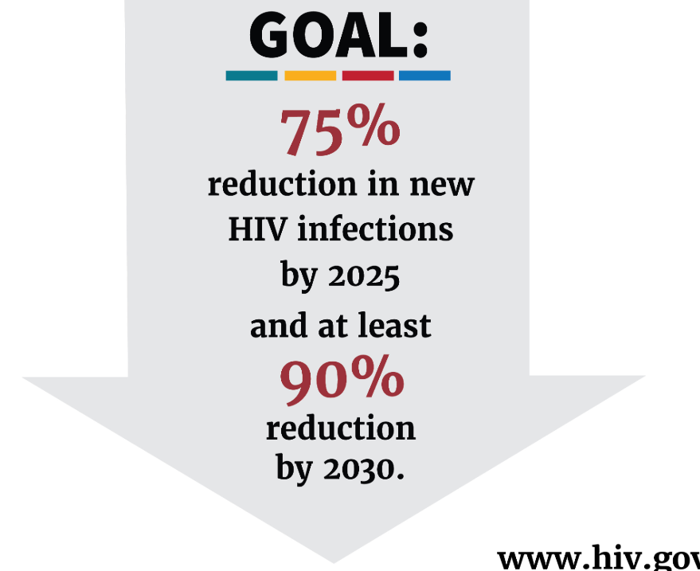
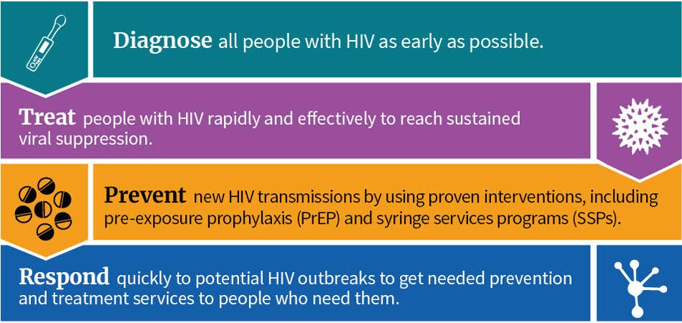
Ending the HIV Epidemic in the US
Source: www.hiv.gov/federal-response/ending-the-hiv-epidemic/overview
Notes:
Ending the HIV Epidemic in the United States is the operational plan for HIV prevention and care and was developed by agencies across the Federal Department of Health and Human Services in 2019. This Department includes CDC which funds HIV surveillance and prevention programs and, HRSA, which administers the Ryan White program.
Its goal is to reach a 75% reduction in new HIV infections by 2025 and at least a 90% reduction by 2030.
<CLICK>
The four key strategies are shown in this infographic.
The first three are
Diagnose all people with HIV as early as possible
Treat people with HIV rapidly and effectively to reach sustained viral suppression
Prevent new HIV transmission by using proven interventions, including pre-exposure prophylaxis (PrEP) and syringe service programs (SSPs)
Today we are discussing the 4th strategy:
<CLICK>
“Respond quickly to potential HIV outbreaks to get needed prevention and treatment services to people who need them”
The genotypes that are reported to the health department provide the information needed to detect outbreaks and clusters. I will go into more detail about this in a bit. I am sharing this this slide to put the work in context.
Before we go to a short break though, I want to show you a few graphs that help answer the question- do the data show us that we are we making progress in this epidemic? Why do you need all this data? How do the data help us see where we need to focus our work? Does using the data help? Does it work?

Slide 28
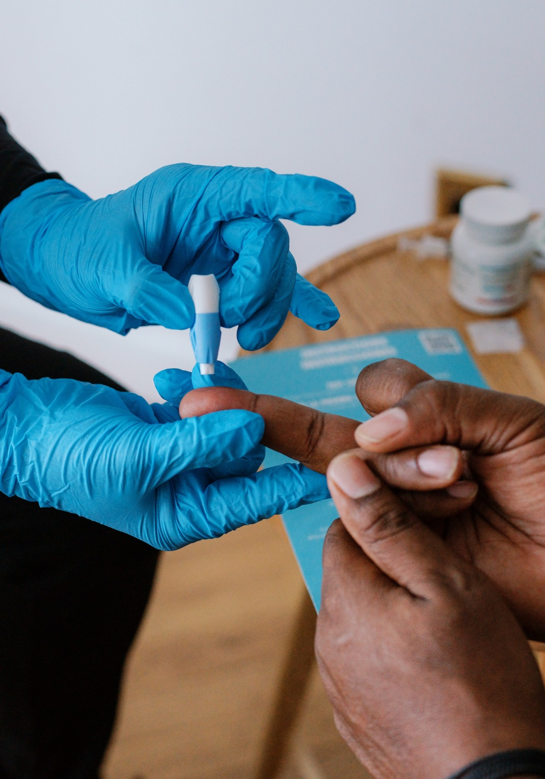
MEASURING HIV PREVENTION GOALS
Role of Surveillance
Photo credit: Building Healthy Online Communities’
How do we know people with HIV are:
Diagnosed?
Linked to care?
Retained in care?
Virally suppressed?
The National HIV Surveillance System is the primary source of data used to monitor HIV trends in the U.S.
WHO REPORTS:
Laboratories
Private/Public Medical Providers
Hospitals
Clinics
HIV Testing sites
WHAT DO THEY REPORT?
HIV tests
Drug resistance/ genotypes
Viral Load
CD4 counts
Notes:
This slide discusses how the HIV surveillance data that I described above in the HIV Case Reporting Data Flow slide are used to measure progress on HIV prevention goals.
<CLICK>
How do we know that people with HIV are:
Diagnosed ?
Linked to care?
Retained in care?
Virally suppressed?
<CLICK>
These are all measured using the surveillance data described in the box on the right side of this slide.
<CLICK>
The National HIV Surveillance System is the primary source of data used to monitor the HIV epidemic in the U.S.
And we USE that information both to prioritize programs that effectively prevent HIV infection and assist people with linking to effective medical care as well as to monitor progress on prevention goals.

Slide 29
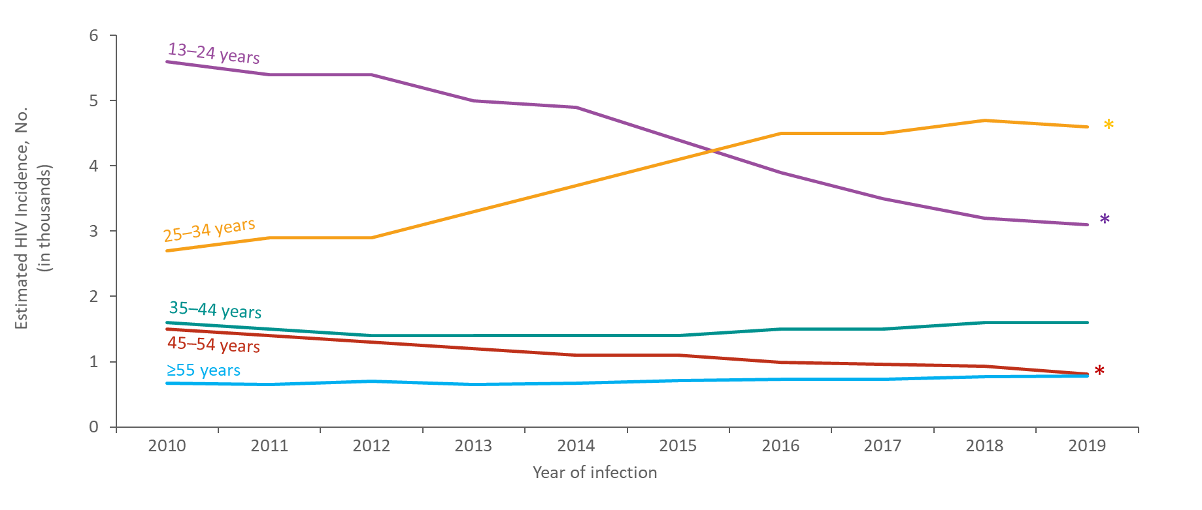
Estimated HIV Incidence among Black/African American Males
Aged ≥13 Years, by Age, 2010–2019—United States
Note. Estimates were derived from a CD4 depletion model using HIV surveillance data.
* Difference from the 2010 estimate was deemed statistically significant (P < .05).
Notes:
These next few slides are from a CDC slide-set that is available online. They all show trends over time in HIV incidence, defined as new HIV infections. This one shows estimated HIV Incidence among Black/African American Males ages 13 and older, by Age group between 2010 and 2019.
To help orient you to these slides, the height of the lines is the # of new infections so here, for example, in the first year, 2010, the highest number among black males was among 13-24 year olds shown in the purple line with about 55,000 new cases that year), but this changed in the middle of the decade and by 2019 the highest number was among 25-34 year olds (shown in gold going from about 28,000 in 2010 to about 46,000 in 2019).
At a glance you can see the progress being made among the youngest group (13-24 years shown in purple) and the work needed in the 25-34 group. Among this group, shown in gold, the number of new HIV infections increased 70% over the decade. Among the younger group, shown in purple, the decrease was 45%
For reference only:
This slide presents estimated HIV incidence among Black/African American males aged ≥13 years by age in the United States from 2010 through 2019.
The annual number of HIV infections in 2019, compared with 2010, increased among Black/African American males aged 25–34 years (70%), but decreased among those aged 13–24 years (−45%) and 45–54 years (−46%); numbers remained stable among those aged 35–44 and ≥55 years.
In 2019, the largest percentage of HIV infections among Black/African American males was among those aged 25–34 years (42%), followed by those aged 13–24 years (28%).
Estimates were derived from a CD4 depletion model using HIV surveillance data. Estimates are rounded to the nearest 100 for estimates >1,000 and to the nearest 10 for estimates ≤1,000 to reflect model uncertainty.
An asterisk (*) next to the trend line indicates that the difference in the estimate for 2019 from the 2010 estimate was deemed statistically significant (P < .05). Differences that were not statistically significant were deemed ‘stable’.
All data presented in this slide set are from the same dataset (reported to CDC through December 2020) and CD4 model used for the HIV Supplemental Surveillance Report “Estimated HIV Incidence and Prevalence in the United States 2015–2019”. Please see the Commentary and Technical Notes for information on the methods used to produce the estimates. The report can be found at: https://www.cdc.gov/hiv/library/reports/hiv-surveillance.html

Slide 30
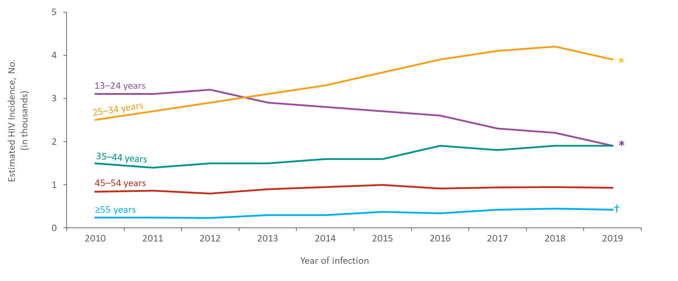
Estimated HIV Incidence among Hispanic/Latino Males Aged ≥13 Years by Age, 2010–2019—United States
Note. Estimates were derived from a CD4 depletion model using HIV surveillance data. Hispanic/Latino males can be of any race.
*Difference from the 2010 estimate was deemed statistically significant (P < .05).
†Estimates should be used with caution; relative standard errors are 30%–50%.
Notes:
This one shows estimated HIV Incidence among Hispanic/Latino Males ages 13 and older, by Age group between 2010 and 2019. You can see trends similar to what we saw with black males in the top two age groups shown in purple and gold. The increase among the 25-34 year olds was 56% over the decade. The decrease among the 13-24 year olds was 39%
For reference only:
This slide presents estimated HIV incidence among Hispanic/Latino males ≥13 years by age in the United States from 2010 through 2019.
The annual number of HIV infections in 2019, compared with 2010, increased among Hispanic/Latino males aged 25–34 years (56%), but decreased among those aged 13–24 years (−39%); numbers remained stable among those aged 35–44, 45–54, and ≥55 years.
In 2019, the largest percentage of HIV infections among Hispanic/Latino males was among those aged 25–34 years (43%), followed by those aged 13–24 and 35–44 years (21%).
Estimates were derived from a CD4 depletion model using HIV surveillance data. Estimates are rounded to the nearest 100 for estimates >1,000 and to the nearest 10 for estimates ≤1,000 to reflect model uncertainty.
Hispanic/Latino males can be of any race.
An asterisk (*) next to the trend line indicates that the difference in the estimate for 2019 from the 2010 estimate was deemed statistically significant (P < .05). Differences that were not statistically significant were deemed ‘stable’.
Estimates for Hispanic/Latino males aged ≥55 years should be used with caution because the RSEs are 30%–50%.
All data presented in this slide set are from the same dataset (reported to CDC through December 2020) and CD4 model used for the HIV Supplemental Surveillance Report “Estimated HIV Incidence and Prevalence in the United States 2015–2019”. Please see the Commentary and Technical Notes for information on the methods used to produce the estimates. The report can be found at: https://www.cdc.gov/hiv/library/reports/hiv-surveillance.html

Slide 31
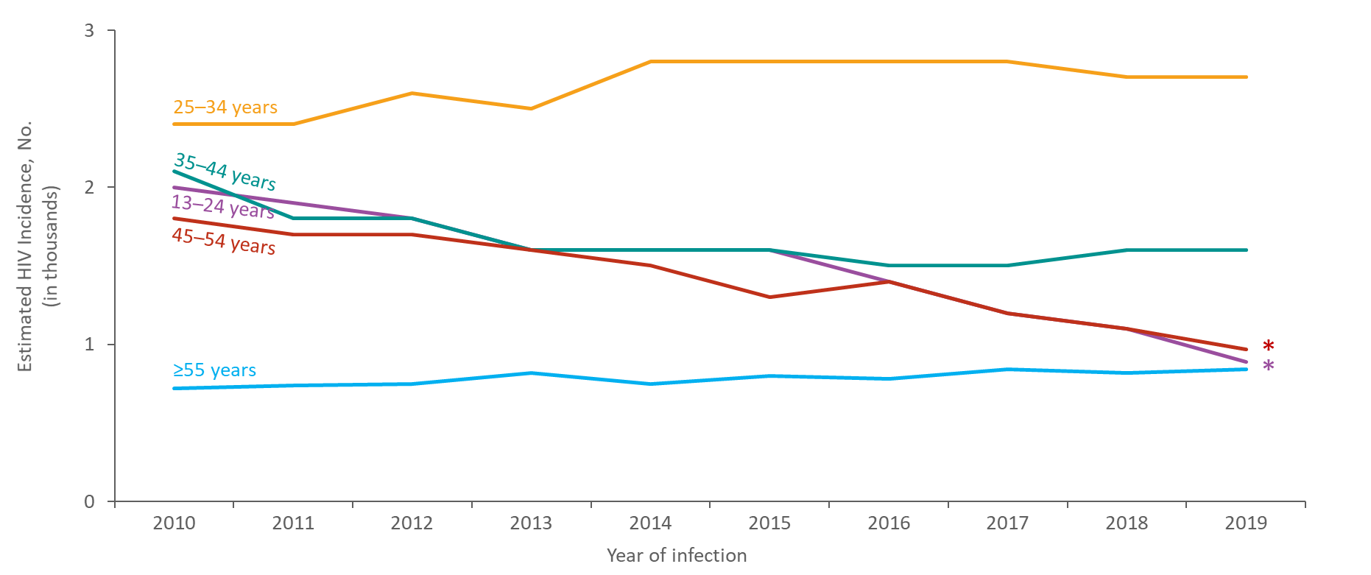
Estimated HIV Incidence among White Males Aged ≥13 Years by Age, 2010–2019—United States
Note. Estimates were derived from a CD4 depletion model using HIV surveillance data.
*Difference from the 2010 estimate was deemed statistically significant (P < .05).
Notes:
This one shows estimated HIV incidence among White males ages 13 and older by age group in the same time period. You can see some differences here. New infections are decreasing among both the youngest age group, shown in the purple line, (a 56% drop) and the 45-54 year olds, shown in the red line, (a 46% drop) while new infections among the largest group- the 25-34 year olds, shown in gold, are stable.
For reference only:
In 2019, compared with 2010, the annual number of HIV infections decreased among White males aged 13–24 years (−56%) and 45–54 years (−46%). The annual numbers of HIV infections remained stable among those aged 25–34, 35–44 and ≥55 years.
In 2019, the largest percentage of HIV infections among White males was among those aged 25–34 years (39%), followed by those aged 35–44 years (23%).
Estimates were derived from a CD4 depletion model using HIV surveillance data. Estimates are rounded to the nearest 100 for estimates >1,000 and to the nearest 10 for estimates ≤1,000 to reflect model uncertainty.
An asterisk (*) next to the trend line indicates that the difference in the estimate for 2019 from the 2010 estimate was deemed statistically significant (P < .05). Differences that were not statistically significant were deemed ‘stable’.
All data presented in this slide set are from the same dataset (reported to CDC through December 2020) and CD4 model used for the HIV Supplemental Surveillance Report “Estimated HIV Incidence and Prevalence in the United States 2015–2019”. Please see the Commentary and Technical Notes for information on the methods used to produce the estimates. The report can be found at: https://www.cdc.gov/hiv/library/reports/hiv-surveillance.html

Slide 32
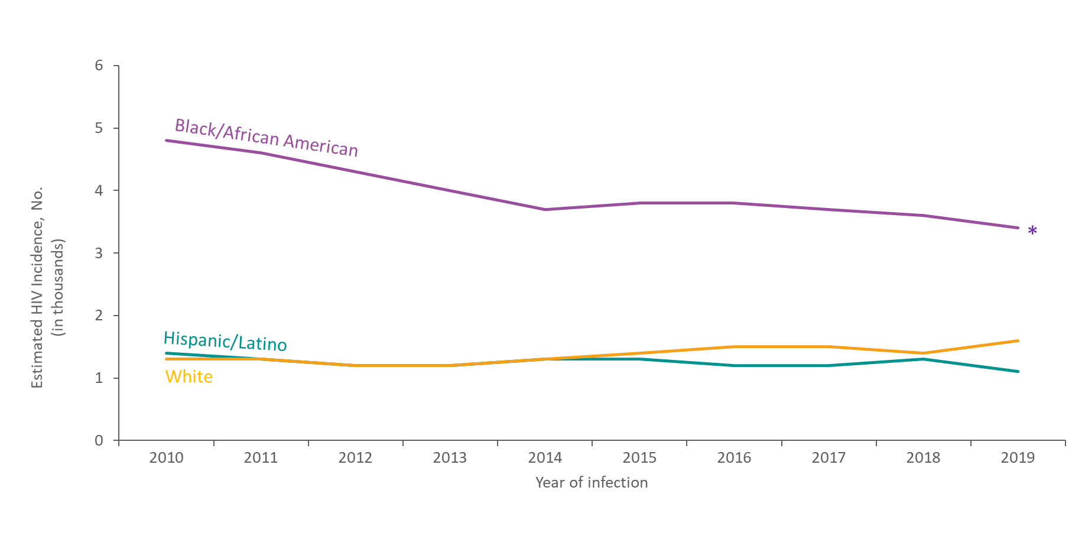
Estimated HIV Incidence among Females Aged ≥13 Years by Race/Ethnicity, 2010–2019—United States
Note. Estimates were derived from a CD4 depletion model using HIV surveillance data. Hispanic/Latino females can be of any race.
* Difference from the 2010 estimate was deemed statistically significant (P < .05).
Notes:
This last data slide is a bit different from the other two and presents estimated HIV incidence among females, ages 13 years or older by race/ethnicity between 2010 and 2019.
You can see by the height of the purple line that most of the female cases are among black women.
In 2019, they made up 53% of all cases among females but show some prevention success with a 29% decrease over the decade.
The number of infections among Hispanic/Latina and White females remained stable.
For reference only:
Estimates were derived from a CD4 depletion model using HIV surveillance data. Estimates are rounded to the nearest 100 for estimates >1,000 and to the nearest 10 for estimates ≤1,000 to reflect model uncertainty.
Hispanic/Latino females can be of any race.
Data for other races are not shown because estimates do not meet the standard of reliability.
An asterisk (*) next to the trend line indicates that the difference in the estimate for 2019 from the 2010 estimate was deemed statistically significant (P < .05). Differences that were not statistically significant were deemed ‘stable’.
All data presented in this slide set are from the same dataset (reported to CDC through December 2020) and CD4 model used for the HIV Supplemental Surveillance Report “Estimated HIV Incidence and Prevalence in the United States 2015–2019”. Please see the Commentary and Technical Notes for information on the methods used to produce the estimates. The report can be found at: https://www.cdc.gov/hiv/library/reports/hiv-surveillance.html

Slide 33

10-MINUTE BREAK
Notes:
Let’s take a 10-minute break. We will start up again at <TIME >

Slide 34
Review and Up Next!
Disease surveillance in general and HIV surveillance and case reporting more specifically
Protecting HIV data from disclosure
How cluster detection and response are part of CDC HIV prevention goals to move the country towards “No New Infections” and is part of the Ending the HIV Epidemic in the US initiative
Next, we will discuss detecting clusters in a bit more detail
Notes:
I want to do a quick review and let you know what’s coming up next.
I have discussed:
Disease surveillance in general and HIV surveillance and case reporting more specifically
Protecting HIV data from disclosure
How cluster detection and response are part of the CDC HIV prevention goals to move the country towards “No New Infections” and is part of the Ending the HIV Epidemic campaign.
Next, we will discuss detecting clusters in a bit more detail.

Slide 35
Using Surveillance Data to Detect and Respond to
HIV Clusters
Notes:
This week we are discussing how we detect clusters. During Part 2 of this series, we will review responding to them.

Slide 36

Detecting Clusters in HIV Public Health Work
Several ways to identify a cluster of cases:
Providers & community- based organizations
Partner services
HIV diagnosis trends
HIV cluster analyses
Based on a slide from the Louisiana Department of Public Health
Notes:
Before going into detail about how we use the reported genotypes to identify clusters I want to put this in context. There are several ways that groups of people with related HIV viruses are identified. Many some of them have been in use for decades.
<CLICK>
To start with, a common way that the HD might be alerted to a potential cluster are from Providers and community-based organizations who may notice an increase and let the health department know what they are seeing
<CLICK>
2) Another way is that the People doing partner services who work with newly diagnosed people, may notice an unusual increase
<CLICK>
3) Third, Health department HIV surveillance staff may see some unusual trends in what is being reported
<CLICK>
4) And 4th, HIV cluster analysis using the genotype data that I have been discussing today.
→Another way that HDs use genotype data to identify clusters is to follow-up on the other methods shown on this slide. The data can confirm whether cases that appear to be related really are or not. HIV started using this method in the early 2000’s. Shortly, I will show you an example of how this was done in Massachusetts.

Slide 37
HIV Case Reporting Data Flow
Local
(City, County)
Health Department
PLWH
WHO?
Private/Public
Medical Providers
Hospitals
Clinics
HIV Testing sites
Laboratories
CDC reports
City, County, State Reports
Websites, Slides, Infographics, News stories
Name
Address
Zip Code
Active Case Finding
WHAT?
HIV tests
Viral Load
CD4 counts
Genotypes
State Health Department
Name
Address
Zip Code
https://www.cdc.gov/publichealthgateway/sitesgovernance/index.html
Notes:
To follow up on the use of genotypes to identify clusters I am showing this slide from earlier today but now I want you to focus on the lower left-hand corner that shows what laboratories report to the health department. “Molecular HIV surveillance” as it has been called previously, is based on receiving genotypes, shown in red, and they are part of the HIV case reporting system and are required to be reported by law or rule.

Slide 38
HIV Genotype Reporting in Context
WHO REPORTS
Private/Public Medical Providers
Hospitals
Clinics
HIV Testing sites
Laboratories
WHAT IS REPORTED
HIV tests
Viral Load
CD4 counts
Genotypes
HIV genotype reporting:
Specific parts of the genetic makeup of HIV
Generated when testing for drug resistances
The information can guide ART
People with similar strains may be part of a group where HIV is spreading rapidly (clusters)
Notes:
Reporting of HIV Genotypes includes specific parts of the genetic makeup of the virus
Genotypes are generated when physicians run tests for HIV drug resistance to guide prescribing effective anti retroviral treatment or medication (ART).
They can also be used to identify people with similar strains where transmission may be rapidly and actively occurring. It allows health departments to reach people and link them to care and/or link them to PrEP to prevent transmission.
I have used the word cluster and its meaning in this context is similar to how the word is generally used. In this context it means a group of people living with HIV whose HIV strain is closely related. Depending on how closely related, they are considered clusters and can indicate a group within which transmission is moving quickly. The genotypes tell us how closely related they are to each other.
<CLICK>
This box on the right side of this slide is from the previous HIV case reporting data flow slide and shows who reports and what they report to the HD.
Various HIV antibody and antigen tests, viral loads, and CD4 counts have used for decades by health departments, to guide prevention and assist people with linking to and staying engaged in care.
<CLICK>
More recently routine reporting of genotypes became part of HIV surveillance practices.

Slide 39

HIV Drug Resistance Testing
Routinely ordered as part of HIV care to guide selection of antiretroviral therapy (ART)
Detects mutations associated with drug resistance
HIV genetic sequence generated
HIV sequences (genotypes) are reported to health departments and CDC
Notes:
This slide shows where the genotypes come from and what they are.
<CLICK>
<SLOW> It starts with HIV drug resistance testing which is routinely ordered as part of HIV care to guide the selection of antiretroviral therapy to make sure that the medications being used are appropriate for the strain.
<CLICK>
This testing detects mutations associated with drug resistance and is done through the generation of the viral genetic sequence.
<CLICK>
The HIV sequences, also called genotypes, are a picture of the genetic make up of a particular strain of HIV.
This is the source of the HIV genotypes that are then reported to health departments and CDC. As a reminder of something I said earlier today, the names of people living with HIV are not reported now nor have they ever, been reported to CDC. The state HD is the highest administrative level that has names and we discussed earlier how that information is protected. In part 3, we will discuss jurisdictional-specific statutes that protect this information.

Slide 40

Definitions
Molecular HIV Surveillance?
“Sounds scary
and science-y”
Molecular HIV Surveillance (MHS)
Cluster Detection and Response (CDR)
Cluster Detection
Cluster Response
Notes:
Okay hold on a minute, some of you might be thinking. What are all these terms you keep using and how are they different from each other?
I’m taking a one slide break here to explain two terms that can cause confusion and concern.
We sometimes hear the phrase molecular HIV surveillance, MHS used interchangeably, with Cluster Detection and Response, CDR.
The MHS term refers to an earlier project that is no longer funded and this term does not describe the full public health response to closely connected cases. CDC no longer uses this term but since it is still used outside of CDC, I wanted to address it here.
<CLICK>
I have heard some people say that it sounds scary and science-y.
This is understandable. The public health community started using it because <SLOW> the molecular data – the genetic patterns of particular strains of HIV (not people), also called genotypes – are what is reported from the labs to the health departments as a part of HIV surveillance. It is the case reporting of molecular information about strains of HIV.
But, as we started using that information to identify groups of people with related HIV strains - called clusters, and, put it in the context of other ways to identify these related cases, (from providers and others in the community that I described a few slides ago), and then, respond to that information, we started using the broader term: Cluster detection and response.
1) Cluster detection includes all ways of detecting or identifying groups of people with related HIV strains. As I discussed above other methods include
Providers and community-based organizations who may notice an increase and let the health department know what they are seeing
Partner services who work with newly diagnosed people, may notice an unusual increase
Health department HIV surveillance staff may see some unusual trends in what is being reported
2) Cluster Response is the essential work that is done after the cluster is identified. It is responding to the information in a way that effectively prevents further transmission of HIV and supports those people living with HIV to help them get access to medical and other care that works for them, to support their health and decrease the likelihood of transmitting it to someone else.
Some people object to the term cluster – it is not meant to dehumanize or objectify people but to describe a relationship among them. For the purposes of preventing the spread of HIV and helping people living with HIV connect to care, it helps to know if individuals are part of a cluster.
People are more familiar with the term outbreak and, during part 2, we will discuss the differences between a cluster and an outbreak but, briefly, outbreaks are larger and, generally, have a wider impact on the community.
I hope this slide was helpful.

Slide 41
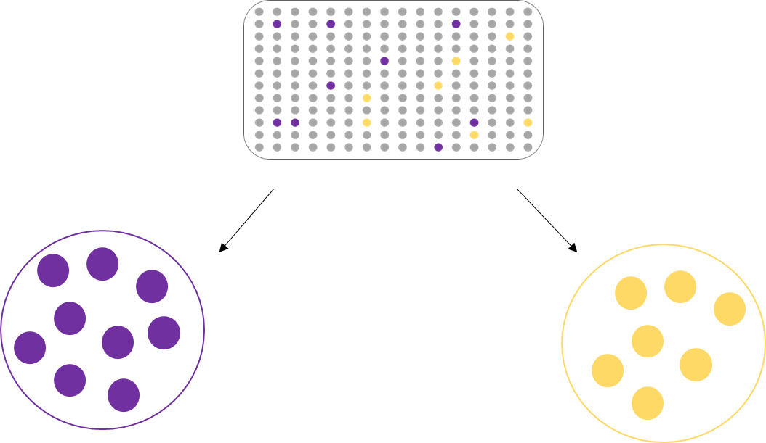
Identifying molecular clusters
HIV evolves over time
Our analysis compares sequences to see how similar or different they are
Looks for sequences that are almost the same (~99.5% similar)
This similarity suggests transmission in the past 2-3 years at most
Groups of people with similar sequences are often referred to as “clusters”
All people living with HIV in a given area
CLUSTER B
CLUSTER A
Based on a slide from CDC
Notes:
Ok let’s go on to how we identify molecular clusters, that is, groups of people with similar HIV sequences.
When we talk about molecular HIV sequence data, it’s helpful to understand just a bit about the molecular epidemiology of HIV and how that
information is used to identify clusters.
Like most viruses, HIV changes over time. It evolves a little differently in each person
Our Molecular HIV analysis compares HIV sequences to determine where they are very similar.
When a group of people have sequences that are very similar, that tells us that they probably got HIV around the same time, likely in the past 2-3 years, and that there are some similarities.
Groups of people with similar sequences are often referred to as “clusters”
It does not tell us the direction of transmission between specific people.
The goal is to understand where more services are needed, not to focus on blame or point fingers

Slide 42
People detected in molecular clusters are only a small proportion of the overall transmission network
Diagnosed, detected in cluster
Diagnosed, not detected in cluster
Undiagnosed
In sexual/drug-using network, do not have HIV
Based on a slide from CDC
Notes:
Even when we detect clusters that appear small, the actual transmission networks are usually quite a bit larger. Some preliminary data are estimating that the people with sequences detected in a cluster [CLICK] represent only about 1/4 of people with HIV in the underlying transmission network. Other people [CLICK] have been diagnosed but aren’t detected as being in the cluster for various reasons, for instance they do not have a sequence or were diagnosed more than 3 years ago.
More than a third of persons [CLICK] are estimated to be undiagnosed.
[CLICK] Beyond the people in the cluster with HIV, there are others who share the sexual or drug using network and who do not have HIV but would be priority candidates for PrEP (for example).
________________________________
[Extra info]
¼ = diagnosed with sequence (12)
36% = undiagnosed (17)
Diagnosed no sequence (19)

Slide 43
Network Where HIV is Spreading Quickly
Reach out to people in these networks
Provide linkage to the services they need
Understand barriers to care and prevention
Develop approaches to overcome them
Based on a slide from CDC
Notes:
Here is another version for visualizing these networks.
Focusing extra attention on these networks can help us to see what resources are needed and target our outreach efforts. For instance, by contacting partners of people in the network,
[CLICK]
we can work to identify other people who might not have known they had HIV or…
[CLICK]
…help people who are at high risk of acquiring HIV, avoid getting HIV.
This slide reflects the actual intervention that we can do with people who are identified as part of a network,
[CLICK]
which is to
Reach out to the network to
Provide linkage to the services they may need,
Understand barriers to care and prevention and
Develop approaches to overcome them.

Slide 44

HIV Transmission Rate in the United States
4 transmissions per 100 people living with HIV per year
Notes:
Part of why this work is integrated into the Ending the HIV Epidemic plan and the CDC Strategic Plan is that transmission in these clusters can be quite rapid.
In general, the HIV transmission rate in the United States is approximately 4 transmissions per 100 people living with HIV per year.

Slide 45
HIV Transmission Rate in First 60 Priority Clusters
21–132 transmissions per year per 100 persons living with HIV
Notes:
This slide portrays the range of transmission rates that CDC measured in the first 60 priority clusters that they helped investigate. Rates ranged from 21 to as high as 132 transmission events per 100 persons living with HIV, indicating the importance of rapid intervention to stop transmission in these networks.

Slide 46
Visualizing HIV Clusters
Notes:
I’ll start to wrap up our session today with a few slides about visualizing HIV clusters

Slide 47





Response interventions can happen various levels
SYSTEM
NETWORK
INDIVIDUAL
Based on a slide from CDC
Notes:
When planning a response to a smaller cluster, it might be tempting only to focus on linking the people identified as part of the cluster to services—for example, linkage to care. This is an important first step, but [CLICK] we also want to make sure that the people in the broader underlying transmission network have access to needed services, Network level interventions might be things like, social network strategies or enhanced partner services. It is also important [CLICK] to think about systems-level changes that might be needed, to make sure that we can continue to reach people with similar characteristics to those in the cluster. In the next slide I provide an example of a HD that has done this in a way that is hopefully manageable and not overwhelming.
Even though we talk about these as different levels, there’s not always a clear distinction—expanded partner services can help bring people into care and can also help better understand the network. Addressing systemic gaps in services, such as expanding testing in emergency departments, linking people to needed services such as housing or food, or offering more gender- or language-inclusive services are examples of interventions that can better serve those in the network as well as making lasting changes so that programs can effectively serve their communities.

Slide 48
People detected in molecular clusters are only a small proportion of the overall transmission network
Diagnosed, detected in cluster
Diagnosed, not detected in cluster
Undiagnosed
In sexual/drug-using network, do not have HIV
Based on a slide from CDC
Notes:
I am putting this slide back up as a reminder that the individuals shown in the first level in the previous slide include all of these – not just those individuals shown in the darkest colored circles whose HIV diagnosis led us to identify the cluster initially.
________________________________
[Extra info]
¼ = diagnosed with sequence (12)
36% = undiagnosed (17)
Diagnosed no sequence (19)

Slide 49
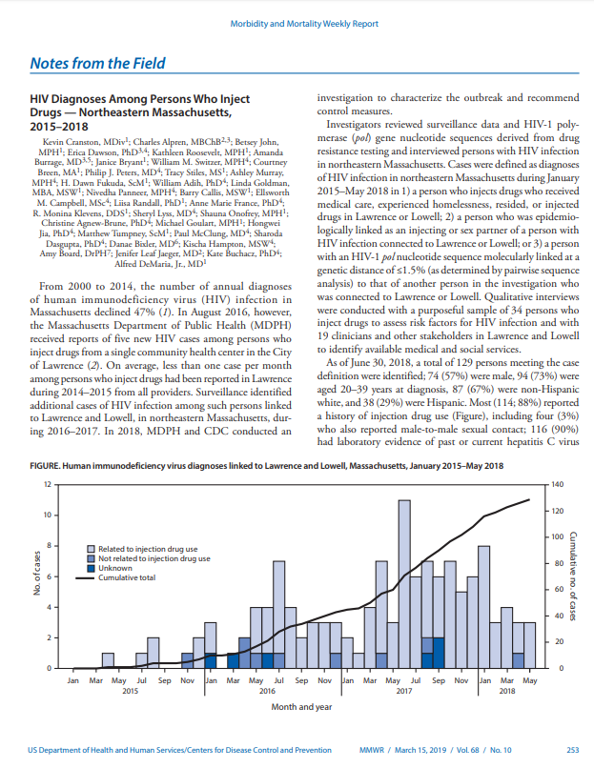
Detection: Field and Molecular Data
HIV Diagnoses Among Persons Who Inject Drugs — Northeastern Massachusetts, 2015–2018
How were people in the outbreak identified?
22% had epidemiologic links* only
53% both molecular and epidemiologic links
25% molecular data only
*linked to other individuals in the outbreak by behavior (e.g., injected drugs), time, and location– also called time/space clusters
Notes:
This slide shares a real-world example of the value of molecular data and how it can provide information to overlay on the other ways to identify clusters that I talked about earlier. It enhances and focuses the PH response to rapid HIV transmission clusters.
I know you can’t see details of the graph, but it is enough to know that along the horizontal axis on the bottom are dates between 2015 and 2018.
The height of each bar is the number of cases and the line going up is the cumulative number of cases growing from 0 in January 2015 to about 130 people in May 2018
This is from an article that was published in CDC’s March 15, 2019 Morbidity and Mortality Weekly Report (usually call the MMWR) about an outbreak in Massachusetts. This mostly affected people who inject drugs in one region of the state.
SLOW
How were people in this outbreak identified?
<CLICK>
22% of the individuals in the transmission network of this outbreak had epidemiologic links. Which means that they were identified as an injecting or sex partner of someone else in the network or they were part of a group of people observed by field staff or providers, who noticed more infections in a short period of time and/or in a particular location. (this is one of the methods of identifying a cluster that I talked about a few slides ago). This clustering during a particular time in a particular location is also called time/space detection.
Let me take a minute here to read the introduction in the MMWR report. It is a classic example of time/space detection.
SLOW so what it says is “From 2000 to 2014, the number of annual diagnoses of HIV infection in Massachusetts declined 47%. <ok, so we’ve have a pretty big decline over a 14-year period> Then, In August 2016…..the Massachusetts Department of Public Health received reports of five new HIV cases among persons who inject drugs from a single community health center in the City of Lawrence. On average, less than one case per month among persons who inject drugs had been reported in Lawrence during [the preceding two years] from all providers;” this is compared to the 5 reported in one month by one provider.
This method of detecting clusters and outbreaks is traditionally, how clusters were identified. However, with reporting of genotypes we gain a method that allows us to better understand whether cases that seem related actually are and to identify cases that we otherwise couldn’t tell were part of the outbreak.
<CLICK>
Going back to the bullets in this slide, we see that 53%, over half, had both molecular data and field related data that linked them to the outbreak, and that
<CLICK>
25% of people in the various clusters that made up this outbreak were found by molecular data alone.
So, without the molecular data comparison between the viruses of people who were diagnosed with HIV during this time, they would not have had the complete picture of the size and patterns of this outbreak. This information helped focus the HD’s work and ensures that they respond in ways that have the most impact on the community in testing, linking to care, and preventing further transmission.
It’s an additional tool that helps overlay more specific information on rapid HIV transmission clusters, but it is not a substitute for traditional field work identifying and notifying needle-sharing partners or outbreak investigation work.
I welcome questions and discussion about this example when we get to that session shortly, so please do note anything you’d like to discuss.

Slide 50
HIV Surveillance: Conclusions
HIV surveillance data are the backbone on which effective and targeted HIV prevention and care programs are designed, planned and evaluated
Data protections are strong and must be maintained to prevent harm to individuals
Cluster detection and response:
  Allows limited resources to focus on those at highest risk in communities where HIV spread is ongoing
  Has the potential to
  Interrupt rapid spread of HIV
  Identify and offer linkage to care and prevention services to individuals
Notes:
Before we have a discussion, I will summarize this section.
HIV surveillance data are the backbone on which effective and targeted HIV prevention and care programs are designed, planned and evaluated
Data protections are strong and must be maintained to prevent harm to individuals
Cluster detection and response:
Allows limited resources to focus on those at highest risk in communities where HIV spread is ongoing
It has the potential to
Interrupt rapid spread of HIV and to
Identify and offer linkage to care and prevention services to individuals

Slide 51
Surveillance
Questions & Concerns
Notes:
I have just presented a lot of information, discussing how HIV Surveillance data drive our response and informs prevention and care activities. Some of this information may be new for you and, regardless, we would like to start a discussion of the topics I have just presented including answering questions that you may have.
We plan to use a menti meter to efficiently allow participants to anonymously ask questions but first, let’s address anything that came up in the chat while I was speaking.
<hold this time for any chat comments that should be addressed before going to the menti-meter>

Slide 52

ACTIVITY
Surveillance drives our response and informs prevention and care activities
“Surveillance? Sounds like someone is monitoring me like Big Brother.”
Notes:
We’ll now move to the mentimeter. For those of you who have not used menti meters before, [person] will direct you to a website where you can sign in and anonymously enter any remaining questions and concerns about HIV surveillance in general or molecular surveillance or cluster detection specifically. We will all see what is typed in and can discuss it.
We’ll get this started using the mentimeter and [person]
TO DO:
Review what’s reported in the mentimeter and encourage discussion of anything that they see or additional thoughts or ideas
Have some questions ready to discuss if people are not putting anything in

Slide 53
Logistics Questions [Virtual]
Notes:
I know we just went through surveillance questions and concerns, but if you have additional questions about this learning series, please feel free to ask them now! Make sure to unmute yourself and state your name/role/pronouns and if you’re comfortable, turn on your camera before you ask your question. Or you’re welcome to put questions in the chat.

Slide 54

Thank You
FOR QUESTIONS CONTACT
Name
Title
Email
Phone
Notes:
NOTE: The presenting jurisdiction can insert their desired contacts’ information on this slide.
As a reminder, the second part of this series is [insert date time and reminder info]

Slide 55
LEARNING SERIES
HIV Cluster Response
Health Department, Provider, and Community Collaboration to RESPOND to HIV Clusters
PART 2
Notes:
Hello everyone, and welcome to the Part 2 of the Virtual Learning Series: HIV Cluster Response: Health Department, Provider, and Community Collaboration to Respond to HIV Clusters. We’re excited to have you all here again!

Slide 56
Expectations and Logistics
[VIRTUAL]
Participation
Participants will be muted to limit background noise, but you may unmute yourself during discussion or Q&A if you want to talk
Will have some interactive components during the webinar
Asking questions
Please submit questions in the chat box and/or can ask verbal questions during Q&A times
Maintaining a safe space for discussion
Webinar will be recorded for internal reference
For IT issues: please email: [insert contact email]

Slide 57
Learning Series
PART 1
Public Health Surveillance Basics & Using Surveillance Data to Detect HIV Clusters
PART 2
Health Department, Provider, and Community Collaboration to Respond to HIV Clusters
PART 3
Addressing Community Concerns: Data Release and HIV Criminalization Considerations & HIV Stigma
Notes:
NOTE: Insert jurisdiction-specific dates to this slide.
As a reminder, today is Part 2 of a three-part learning series.
Today we will focus on HD and partner responses to HIV clusters, and the roles that organizations and community members play in this activity. Part 3 will focus on policy issues around the implementation of HIV cluster response, along with stigma’s role in HIV cluster detection and response.

Slide 58
Three-Part Learning Series Objectives
Understand the history and concepts behind public health surveillance including ethics, consent, and data protection for HIV surveillance data
Explain the basic process, benefits, and drawbacks of HIV cluster response
Effectively communicate with community members/clients/patients about common cluster response concerns
Notes:
In Part 1, we discussed HIV surveillance basics and the process for detecting transmission networks or HIV clusters. Once again, these are the three objectives for the full series.
NOTE: Please alter these objectives based on the specific takeaways that you hope for the participants to gain.

Slide 59
Objectives for Today
Understand the range of interventions used to respond to HIV clusters and outbreaks
Gain examples of how health departments have responded to HIV clusters “on the ground”
Describe the different roles played by the health department and partners (including providers and community-based organizations) in cluster response activities
Understand the role of community engagement in cluster response and some benefits and concerns about responding to clusters
Explore communication to find common ground on HIV cluster detection and response activities
Notes:
NOTE: Please alter these objectives based on the specific takeaways that you hope for the participants to gain.

Slide 60
Agenda for Today
Responding to HIV Clusters Using Surveillance Data: Health Department and Partner Roles
Breakout Room #1
“Real World” Health Department Experiences with Cluster Response
Community Engagement
Breakout Room #2
Q&A and Wrap Up
Notes:
NOTE: The presenting jurisdiction should alter this slide to their specific agenda.
This is our agenda for today. [read from slide]
Now, I will get us started with responding to an HIV cluster.

Slide 61
Responding to HIV Clusters Using Surveillance Data: Health Department and Partner Roles
Notes:
This section discusses how health departments have used surveillance data to respond to clusters.

Slide 62
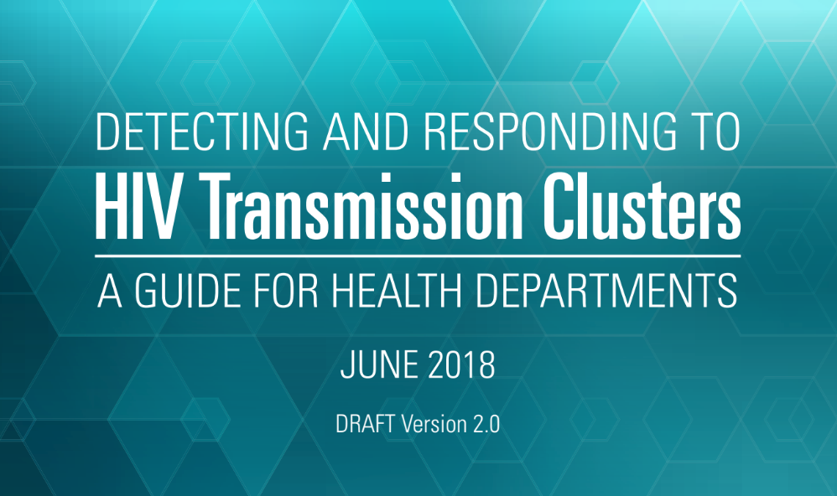
Cluster vs. Outbreak
A textbook definition of an outbreak is
Determining whether an increase in HIV diagnoses or the identification of a transmission cluster warrants an escalated response is an iterative process, and multiple factors, including those outlined in CDC’s cluster detection and response guidance and HIV CDR FAQs, should be considered.
“an increase, often sudden, above what is normally expected in that population or area,”
the term is often used to describe situations in which an urgent or emergency-level public health response is needed.
Source: https://www.cdc.gov/hiv/pdf/funding/announcements/ps18-1802/CDC-HIV-PS18-1802-AttachmentE-Detecting-Investigating-and-Responding-to-HIV-Transmission-clusters.pdf
Additional resource: https://www.cdc.gov/hiv/programresources/guidance/cluster-outbreak/faq.html
Notes:
First, a word about the terms cluster vs. outbreak… sometimes, these are used interchangeably. There’s no one set definition in terms of numbers in what constitutes an “outbreak” versus a “cluster;” it can come down to decision making at the local level, especially in terms of messaging and communicating with the community.
<CLICK>
While a textbook definition of an outbreak is “an increase, often sudden, above what is normally expected in that population or area,” the term is often used to describe situations in which an urgent or emergency-level public health response is needed.
<CLICK>
Determining whether an increase in HIV diagnoses or the identification of a transmission cluster warrants an escalated response is an iterative process, and multiple factors, including those outlined in CDC’s cluster detection and response guidance, should be considered.

Slide 63
Larger clusters more intense response resources needed
ESCALATED
RESPONSE
Incident command/
enhanced coordination
EXPANDED RESPONSE
Address additional service gaps
Broaden scope of response
ESCALATING RESPONSE NEEDS
INITIAL RESPONSE
Early engagement of community partners
Focused investigation and response activities
ROUTINE REVIEW
Review, discussion and prioritization
of potential clusters and outbreaks (ongoing)
Notes:
This slide, based on one from CDC shows that, additionally, although large responses are highly visible, cluster detection and response spans [CLICK] routine, day-to-day efforts to identify and prioritize clusters; [CLICK] initial response to small clusters, including early engagement of community partners and focused investigation and response activities; [CLICK] expanded response to address additional service gaps and broaden the scope of the response, or [CLICK] escalated response to the most concerning clusters and outbreaks. Responding to clusters while they are still small is important to limit transmission.
[CLICK] As clusters get larger, they require more resources. Responding to clusters when they are smaller can help keep efforts manageable.

Slide 64
Responding to a cluster could look like…
Increasing PrEP outreach and navigation services to community
Partner services interviewing individuals in the cluster network to gather information
Providing HIV testing to individuals linked to a cluster who haven’t been tested for HIV
Linkage to care for new diagnoses
Address viral suppression and barriers
Offering PrEP services to individuals who may be at risk
Increased targeted HIV testing or other prevention services in the community
Educating providers on cluster trends
Increasing harm reduction programs and other substance use services
Working with neighboring jurisdictions for clusters across states lines
Sending a health alert to community/priority populations
Notes:
The way a HD responds to a growing network of HIV will differ depending on the details of the individuals involved and the HD’s priorities. Responding to a cluster could look like:
1 <CLICK>
Partner services interviewing individuals in the cluster network to gather information
2 <CLICK>
Providing HIV testing to individuals linked to a cluster who haven’t been tested for yet
Linkage to care for new diagnoses
Addressing viral suppression and barriers
Offering PrEP services to individuals who may be at risk
PrEP, or Pre-exposure pro-phylaxis, is an HIV-preventative drug that people at risk of HIV can take once daily.
3 <CLICK>
Increased targeted HIV testing or other prevention services in the community
4 <CLICK>
Sending a health alert to community/priority populations
5 <CLICK>
Educating providers on cluster trends
6 <CLICK>
Increasing harm reduction programs and other substance use services.
7 <CLICK>
Working with neighboring jurisdictions for clusters across state lines
8 <CLICK>
Increasing PrEP outreach and navigation services to community
As you can see on this list, at a basic level, cluster response involves many traditional HIV prevention services that have been around for a long time and that many of us are familiar with- including partner services, PrEP (pre-exposure prophylaxis), and SSPs (syringe service programs)- but in a more focused way at the individual, network and/or community-specific level. Health departments can and should collaborate with CBOs on these activities, too. Cluster detection and response provides an opportunity to identify and address gaps in the full range of HIV prevention services. Often, a cluster indicates that there were missed opportunities, and one of the benefits of cluster detection and response is that it can be helpful in making decisions about where to allocate resources (key populations, geographic areas), or help scale-up programs that already exist in the community.

Slide 65
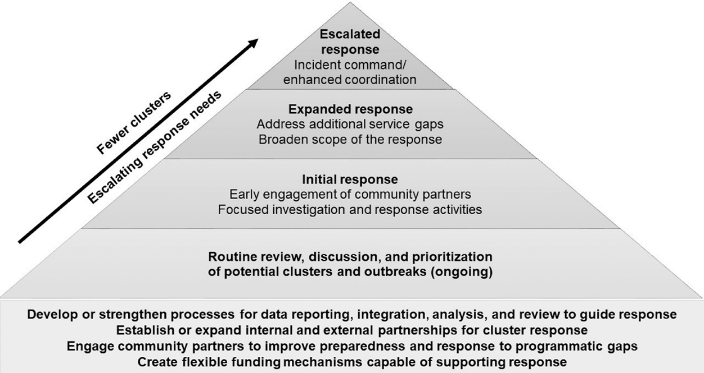
Spectrum of Response
Use lessons from escalated response to inform routine CDR implementation
Source: Oster AM, Lyss SB, McClung RP, et al. HIV Cluster and Outbreak Detection and Response: The Science and Experience. Am J Prev Med. 2021;61(5S1):S130-S142. doi:10.1016/j.amepre.2021.05.029
Notes:
•Talk about the difference between what a routine vs. escalated response might look like and the importance of planning for both.
•Key takeaways from the CDC article:
•“Response efforts should be scaled to the size and characteristics of the cluster or outbreak and the needs of the transmission network. Although large outbreak responses are often highly visible, CDR also includes intervening in the many clusters detected while still small, which can most effectively limit transmission. Therefore, CDR spans routine, day-to-day efforts to identify and prioritize clusters; both initial response to small clusters; and expanded or escalated response to more concerning clusters and outbreaks”
•“…Groups experiencing rapid transmission do not necessarily mirror those with higher numbers of diagnoses and that these groups change over time and show substantial geographic variation. Therefore, ongoing, routine analysis by HDs is necessary to identify the networks experiencing rapid transmission."
•Also recognize that lessons learned from escalated response also need to be fed back into routine response planning and program improvement (e.g., gaps identified should inform future resource/services allocation)
•In addition, many of the same underlying resources and capacity (e.g., building partnerships, identifying funding flexibilities for targeting/adapting response) are needed for both

Slide 66
Responding to a Cluster
HIV PREVENTION & PARTNER SERVICES
COMMUNITY
HIV SURVEILLANCE DATA
HIV CARE
Notes:
The process of identifying and responding to rapid HIV transmission clusters involves collaborations within the health department between the prevention, surveillance, and care programs.
Throughout this process, it’s important to keep community members informed and involved, meaning PLWH, health care providers, and community-based organizations.
<CLICK>
Whether responding to a cluster or an outbreak, the broader community should be involved in an ongoing way and one that doesn't further stigmatize those trying to be reached with prevention services. Having community members involved with the HD programs on this slide can assist with minimizing stigma in the planning process and response. CBOs can provide support in connecting community members with cluster or outbreak response.

Slide 67
HEALTH DEPT.
PROVIDERS
CBO
Communication with community & HIV care providers
Collaborate with partners, other county and state HDs, or other units within the HD (hepatitis, emergency preparedness)
Surveillance: cluster detection (through time-space and/or genetic sequence data), ongoing routine surveillance monitoring
Prevention: prioritizing and coordinating interventions to respond (testing, PrEP linkage, partner services), community engagement
Care: linkage to care, linkage to RWHAP services such as housing
HIV testing
Timely and complete reporting to the health department
Drug-resistance testing
Monitoring unusual patterns in new diagnoses
Modifying care models to respond to needs of PLWH
HIV testing and timely reporting to HD
Implement interventions to respond to cluster (e.g., venue-based testing, risk-based communication, access to PrEP, housing assistance, health insurance assistance)
Educating community and providers
Notes:
This chart lays out some of the potential roles for Health Departments, Providers, and Community Based Organizations (CBOs)in responding to clusters.
I know this slide is dense, so we will talk about each of these separately in more detail next.
As shown in the horizontal arrow, health department communication with providers and CBOs will strengthen the response to clusters, as they often have trusted relationships with community members. Overall, these three concepts are connected and can’t happen in silos. HDs, providers, and CBOs must communicate and collaborate on an ongoing basis for the most effective response to clusters and outbreaks.

Slide 68
Health Department Roles
Notes:
First, we’ll go into more detail about health department roles.

Slide 69

HD Funding for Cluster Detection and Response
CDC PS18-1802
Core Required Strategy #3:
“Develop, maintain, and implement a plan to respond to HIV transmission clusters and outbreaks”
Outcome 1: Improved early identification and investigation of HIV transmission clusters and outbreaks
Outcome 2: Improved response to HIV transmission clusters and outbreaks
Outcome 3: Improved plans and policies to respond to and contain HIV clusters and outbreaks
Notes:
Health department CDR work is funded through CDC’s funding opportunity PS18-1802, which began in 2018 and initially provided five years of funding. It has been extended through May 31, 2024. This is the federal funding mechanism for health department HIV prevention and surveillance programs in the U.S.
Under 18-1802, Cluster and Outbreak Detection and Response became a required core activity for all health departments for the first time.
The intended outcomes set forth by CDC for CDR are outlined in the slide (read through).
Outcome 1 <CLICK>
Outcome 2 <CLICK>
Outcome 3 <CLICK>
Some health departments are also funded through PS20-2010 and other Ending the HIV Epidemic funding (like HRSA). Pillar 4: Respond, one of the four core pillars of EHE, also supports many cluster response activities.
Some of this may change when the surveillance and prevention RFP is released, anticipated in 2024.

Slide 70
Health Department Foundational Activities
ETHICAL IMPLEMENTATION
Engage community, including people with HIV, providers, and community-based organizations
Assess data protections and enhancing related policies and procedures when necessary
Assess implications of criminal exposure laws
EFFECTIVE IMPLEMENTATION
Develop internal and external health department collaborations
Develop capacity for cluster detection
Assess prevention portfolio and fiscal mechanisms needed for response
From: Implementation Guidance for PS18-1802 Strategy 3: Cluster Detection and Response, November 2018 (CDC)
Notes:
<CLICK>
As part of the phasing-in of CDR activities, HDs around the country were tasked by the CDC with completing these “Foundational Activities.”
As part of ethical implementation, the activities are:
Engage community, including people living with HIV, providers, and community-based organizations
Assess data protections and enhance related policies and procedures when necessary
Assess implications of criminal exposure laws, which we’ll discuss in more detail in next week’s webinar
As part of effective implementation, the activities are:
Develop internal and external health department collaborations (June 2019)
Develop capacity for cluster detection
Assess prevention portfolio and fiscal mechanisms needed for response

Slide 71
HEALTH DEPT.
PROVIDERS
CBO
Communication with community & HIV care providers
Collaborate with partners, other county and state HDs, or other units within the HD (hepatitis, emergency preparedness)
Surveillance: cluster detection (through time-space and/or genetic sequence data), ongoing routine surveillance monitoring
Prevention: prioritizing and coordinating interventions to respond (testing, PrEP linkage, partner services), community engagement
Care: linkage to care, linkage to RWHAP services such as housing
HIV testing
Timely and complete reporting to the health department
Drug-resistance testing
Monitoring unusual patterns in new diagnoses
Modifying care models to respond to needs of PLWH
HIV testing and timely reporting to HD
Implement interventions to respond to cluster (e.g., venue-based testing, risk-based communication, access to PrEP, housing assistance, health insurance assistance)
Educating community and providers
Notes:
Health department work includes collaboration among the state and local health departments. Each plays a different role with, DIS usually located at the local level. Within the HD itself, different programs have different roles to play.
The Surveillance program is responsible for the “detection” piece of Cluster Detection and Response. We discussed this in detail during Part 1 of this series, so now we’re going to discuss prevention and care.
The prevention and care programs within the state and/or local HDs are the primary programs doing the “response” work, including prioritizing and coordinating interventions to respond (such as testing, PrEP linkage, partner services), and linkage to care, and to RW services such as housing.
As I mentioned earlier, it’s also key for all three programs – surveillance, prevention, and care – to collaborate internally, and with local, state, and, if the outbreak is multijurisdictional, with neighboring HDs. Depending on the cluster specifics, there may also be collaboration with other HD units, such as emergency preparedness, or the hepatitis program if there are co-occurring outbreaks or risk factors.
Community engagement is about developing trusted relationships between all three areas of the health department and community members. We will discuss this a bit later today.

Slide 72
Health Department HIV Program Roles:
Surveillance
Surveillance: [insert health department here]
Identify groups of related partners using Secure HIV-TRACE
Link partner services, STI surveillance other data to broaden the picture of the cluster and expand the cluster’s transmission and risk networks
Prioritize clusters based on all available data
Monitor existing and new clusters including when to close a cluster response
Decide when to close a cluster response
Notes:
NOTE: The presenting health department should alter this slide and the notes to meet their surveillance department's specifics.
Beyond the basic steps I just discussed, here are some HD roles in ongoing cluster detection work in [Jurisdiction]:
First up, we have [state HD name’s] surveillance activities:
During Part 1 we talked about some of the mechanics of disease surveillance in general and HIV surveillance more specifically.
This slide talks about how the HD surveillance program identifies and prioritizes clusters using molecular data, surveillance data, and partner services data.
Groups of related partners are identified by analyzing the genotypes that are reported to the HD using a tool called Secure HIV-TRACE.
Surveillance uses all available data including partner services and STI surveillance data to broaden the picture of the cluster and prioritize responding to multiple clusters, as needed
Ongoing monitoring of existing and new clusters is also a surveillance role.
Once a cluster has been identified, the HD monitors it to assess whether there is ongoing transmission and when to close the response.

Slide 73
Health Department HIV Program Roles:
Prevention
Prevention and Service Linkage: [insert HD name here]
Initiate additional investigations and decide which services are needed
Partner services
Funding CBOs to provide prevention services
Linkage to HIV care and/or re-engagement in care
Linkage to other support services
Community engagement
Notes:
NOTE: This slide and its notes about prevention should also be tailored to the specifics of the presenting health department.
Next, we have the prevention and care program roles:
The HIV prevention program and some functions of service linkage to care are led by [insert correct HD name]
They initiate additional investigations and decide which services are needed
Examples include:
Partner services, which includes offering partner elicitation and notification, and HIV testing
Funding CBOs and other agencies to provide HIV prevention work
And linkage to HIV care and/or re-engagement in care and other support services, such as housing, transportation, dental care, and substance use and mental health services.
Lastly, community engagement conducted should continue to inform the HD’s work, in how they respond to clusters, identify gaps in services and barriers, and prioritize response activities. <Insert name> will discuss community engagement in more detail later in today’s webinar.

Slide 74

Cluster Response:
Prioritizing Response Activities
Prioritization may be based on:
Number of people in cluster and number of available response staff
Demographics (prioritize groups that are seeing recent increases based on local data on new infections)
Networks with characteristics suggesting high potential for ongoing transmission such as injecting drugs
Clinical variables related to potential adverse health outcomes:
Out-of-care
Unsuppressed viral load
STI or hepatitis co-infection
Notes:
On this slide I want to discuss prioritizing outreach in a bit more detail
Prioritization of outreach is different from surveillance prioritization of which clusters to respond to.
Prevention prioritization is based on:
Number of people in a cluster with clinical variables that increase their risk of illness, for example, as well as the number of available response staff
Demographics (that is, prioritize groups that are seeing recent increases based on local data on new infections)
Networks with characteristics suggesting high potential for ongoing transmission such as injecting drugs
And lastly, prioritization is based on clinical variables related to potential adverse health outcomes, such as people being:
Out-of-care
Having Unsuppressed viral loads
or STI or hepatitis co-infections

Slide 75
HIV Health Department Roles:
Care
Care Administration: [insert correct RW program name]
Administers Ryan White Program funding to agencies for care services and service linkage
Notes:
NOTE: The presenting health department should tailor this slide and the notes to the specifics of their health department.
HIV Care administration, the [insert correct name] “administers” the Ryan White Program funding. Their Ryan White Program funds other agencies performing linkage to HIV care and/or also provides funding to agencies who can offer direct HIV care services.

Slide 76
Cluster Response:
Capacity
Additional staff training needs and retention
Maintaining “core” support areas while resources are being drawn to respond to clusters
Shifting current staff
Requesting additional assistance from state or federal government for significant clusters/outbreaks
Assess flexibility of existing funding mechanisms to shift activities (e.g., testing) to other venues or locations in the event of a cluster or outbreak
Notes:
As you can see, Cluster detection and response can be a time- and resource-intensive intervention for health departments.
<CLICK>
As a relatively new type of HIV prevention activity, there may be a need to offer additional training for staff working on cluster detection and response implementation. Staff retention can also be a challenge at health departments, in general and it has increased as a problem in more recent years. Many HDs experience high turnover for field staff and hiring and training for new Disease Intervention Specialists (DIS) and Linkage to Care workers can take a long time. It’s not easy to build the skill set needed to do effective linkage work, and staff vacancies for state/local government positions can take a long time to fill.
<CLICK>
Another consideration is maintaining “core” support areas while resources are being drawn to respond to clusters, especially during an escalated response to a larger cluster. Having a protocol that clearly outlines staff roles and how to shift staff, if necessary, to engage in cluster response, is an important part of planning.
<CLICK>
For larger clusters/outbreaks, health departments may also need to request outside assistance. For local health departments, this may be from the state HD. On the federal level, the CDC has also assisted HDs with responding to significant outbreaks by deploying staff to support the local/state HD.
<CLICK>
Finally, HDs can assess how to build flexibility into funding sources they use to support cluster response and related activities. This would support resource allocation resources and scale up services where they are needed in the event of a cluster or outbreak in a particular population or geographic area.

Slide 77

Cluster Response:
Staff Turnover
This has been an ongoing problem since the start of the COVID pandemic
To minimize challenges from this, document cluster detection and response policies and procedures for future hires
CDC required HIV Cluster and Outbreak Detection and Response Plan
Update this regularly to ensure staff always have access to latest information
Notes:
Staff turnover has been an ongoing problem in the time since the start of the COVID pandemic
Documenting cluster detection and response policies and procedures will support continuity
Each health department was required to submit an HIV Cluster and Outbreak Detection and Response Plan during summer of 2021
The plan could "jumpstart" a policy and procedure manual that can be edited to realistically reflect what the HD actually does

Slide 78
Coordinating with Health Department Partners
Learn from STD, hepatitis, tuberculosis, emergency outbreak response experiences in same health department
Field staff
Developing pre-emptive data sharing agreements with bordering jurisdictions will expedite an effective response
Notes:
When it comes to cluster response, there are several ways that HD HIV programs can collaborate with other partners within their HD or at other HDs.
<CLICK>
When planning cluster and outbreak response activities, HIV programs can learn from other programs within the HD that have a long history of infectious disease outbreak response work including STD, viral hepatitis, tuberculosis, or emergency preparedness programs. When responding to an actual cluster or an outbreak, these partners can be collaborators as well – for example, working with the hepatitis program if there is a co-occurring outbreak of HIV and hepatitis among PWID, or the emergency preparedness staff for a large outbreak if escalated, large-scale response is necessary. Additionally, keeping an eye on hepatitis and STD clusters early on can help prevent or minimize a subsequent HIV outbreaks.
<CLICK>
The category of “field staff” may include Disease Intervention Specialists (DIS), Linkage to Care staff, Case Managers, or other navigators or outreach staff roles who typically work one-on-one with clients to provide services. I mention the field staff separately because they are USUALLY IN THE STD Program SO HDs MAY NEED TO COORDINATE THE STD AND HIV RELATED ACTIVITIES. I will discuss this in more detail next, including some of the specific roles in [presenting jurisdiction].
<CLICK>
Finally, it may be necessary to collaborate with other health departments for clusters that cross state/county/city lines depending on the specifics of the cluster/outbreak. Doing some pre-emptive planning work with bordering HDs or other local partners – for example setting up data sharing agreements or protocols - can help ensure that response runs smoothly and efficiently in the event of a cross-jurisdictional cluster.

Slide 79
Evolving Roles of Field Staff & Service Linkage Workers
Re-engagement in care
Integrated Services (HIV, Hepatitis, STDs)
Pre-exposure Prophylaxis (PrEP)
Overdose Prevention
Insurance Navigation
Data to Care (D2C)
HIV CLUSTER RESPONSE
Notes:
As the way we respond to the HIV epidemic has shifted over the years, field staff in many jurisdictions have taken on new and innovative roles, including… [read list of blue boxes from slide]
I’m referring to “field staff” here generally. But depending on the HD, the names and specific roles vary, and there may be a combination of different staff who perform certain pieces of these roles. In some jurisdictions, several of these activities, along with partner elicitation/partner services, are done by Disease Intervention Specialists/DIS. In [specific jurisdiction… discuss DIS specific roles]
Field staff (whether DIS, etc.) usually have a deep understanding of the communities they work in, connections to local resources, and a unique set of skills in working one-on-one with PLWH and their partners. However, increasingly more is being asked of these staff with the integration of STD/HIV prevention and care services, so it’s a delicate balance when it comes to capacity and staff burnout, especially as many of these staff were originally brought in to help with COVID contact tracing.
<CLICK>
Cluster response (at the bottom) can be another one of these newer and evolving roles, and response to an active cluster can also amplify the need for these other functions (for example, PrEP).
For DIS who are involved in this work, cluster response activities might be a shift from their usual focus on “traditional” partner services functions, which center primarily on new diagnoses. Sometimes for a cluster, DIS might re-interview individuals who may already be in care.

Slide 80
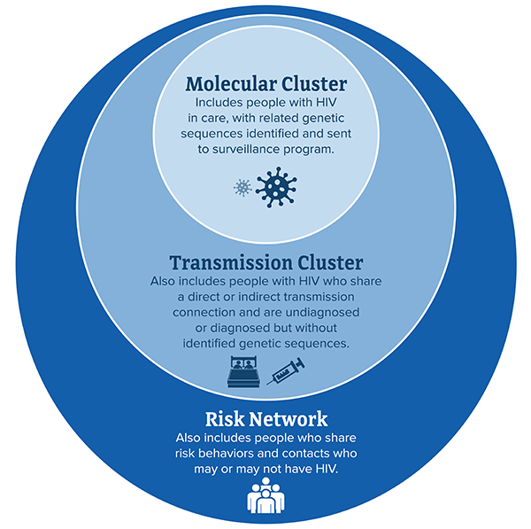
Possible Health Dept. Staff Roles in Cluster Response
Gathering detailed information about newly-diagnosed individuals linked to a cluster to assist with investigation
Linking newly-diagnosed PLWH to care and/or additional testing, or re-linking
Facilitating partner testing, linkage to PrEP if applicable
Referring to wraparound services to address barriers to care
Educating clients about risk and health department activities
Image source: CDC
Notes:
I’m now going to revisit the concentric circle model of cluster response we reviewed in last week’s session to talk about how HD staff in different programs may be involved with different groups.
<CLICK>
First, to briefly review the different “rings” of this model that were discussed in last week’s session:
The outer ring is the risk network, which includes the people who are not HIV-positive but may be at risk for infection and the HIV positive persons in the transmission and molecular clusters.
The transmission cluster, center ring, is a subset of the risk network. Members of this ring are all HIV positive, but the health department doesn’t yet have genotype data, and they may not all be diagnosed.
The molecular cluster is a subset of the Transmission Cluster and contains only the people for whom molecular data (genotypes) are available and can be analyzed; these people are diagnosed, have been in care, had resistance testing done, and had their genotype reported to the health department.
Now I’m going to talk about different types of HD staff may be involved in some capacity with all these groups in the course of a cluster investigation and response:
<CLICK>
HD staff, typically Disease Intervention Specialists (DIS) who perform partner services work, are well positioned to gather detailed information about newly-diagnosed individuals linked to a molecular cluster, or in some cases, re-interview individuals who are part of a molecular cluster if detailed information about partners and risk factors wasn’t gathered initially. They might also notice unexpected increases or patterns in new diagnoses that may be related to the molecular cluster; those would be part of the second level -- transmission cluster.
Then, we have linking newly-diagnosed PLWH to care and/or additional testing, or re-linking to care for those previously diagnosed but may not currently be receiving HIV care.
For those in the transmission cluster who are newly diagnosed, DIS in some states can refer people to Linkage Coordinators who can assist with linkage or relinkage to care for those in the molecular or transmission clusters.
<CLICK> <CLICK> <CLICK>
Next, we have facilitating partner testing and linkage to PrEP
Partner notification and testing would primarily be done to identify those in the transmission cluster and risk network who may be undiagnosed. The state HD may collaborate with local and regional health departments to facilitate partner testing and HD staff may go back to the partners of cluster members, even if the cluster members are not newly diagnosed, to retest partners who did not test positive previously to assess their current status and refer them to PrEP (if appropriate).
The outer ring, the risk network, includes persons who may be contacts of those in the molecular or transmission clusters, but who haven’t been linked to the cluster yet and whose HIV status is unknown. Field staff can assist with testing, and linkage to PrEP for individuals within the risk network who test negative and may be at risk of acquiring HIV. In some jurisdictions, a PrEP Navigator or DIS may perform this role depending on the jurisdiction.
<CLICK>
Next, there is referring to wraparound services to address barriers to care
For all three levels in the cluster, HD staff may provide referrals to wraparound services such as housing and mental health
<CLICK>
Lastly, educating clients about risk and health department activities
Since they are on the frontlines, DIS or Linkage Coordinators are also often the “face” of the HD to individuals in a cluster or in the risk network so they play an important role in general education about cluster response or the HD’s overall HIV prevention activities.

Slide 81

Coordinating with External Partners
Providers
Community-based organizations (CBOs) or AIDS Service Organizations (ASOs)
Community and community networks
Notes:
Health departments will also coordinate with partners external to the health department including healthcare providers, CBOs and/or ASOs, and directly with the community and community groups. We’ll talk a bit more about providers and CBOs specifically next, then towards the end of our session today, we will dive deeper into community engagement.

Slide 82
Providers
Notes:
Now we will discuss providers’ roles in CDR work

Slide 83
HEALTH DEPT.
PROVIDERS
CBO
Communication with community & HIV care providers
Collaborate with partners, other county and state HDs, or other units within the HD (hepatitis, emergency preparedness)
Surveillance: cluster detection (through time-space and/or genetic sequence data), ongoing routine surveillance monitoring
Prevention: prioritizing and coordinating interventions to respond (testing, PrEP linkage, partner services), community engagement
Care: linkage to care, linkage to RWHAP services such as housing
HIV testing
Timely and complete reporting to the health department
Drug-resistance testing
Monitoring unusual patterns in new diagnoses
Modifying care models to respond to needs of PLWH
HIV testing and timely reporting to HD
Implement interventions to respond to cluster (e.g., venue-based testing, risk-based communication, access to PrEP, housing assistance, health insurance assistance)
Educating community and providers
Notes:
For Providers, common roles will be providing direct services and care to their patients, such as offering HIV testing and drug-resistance testing for individuals who test positive and PrEP for those who test negative. The care should be responsive to their patients’ needs to ensure patients are comfortable and able to remain engaged in HIV care without barriers. Providers also must report their data in a timely manner to the HD as required by law. Sometimes, providers may also be in a unique position to detect the beginning of a “time-space” cluster if they notice unusual patterns in new diagnoses of HIV among their patient population, and they can then inform the HD to prompt further investigation.

Slide 84
Provider Roles:
Connecting to the Health Department
Tell patients that HIV is reported to the health department along with all other reportable diseases
Health department may contact them
Assist with notifying partners
Provide services such as Ryan White HIV/AIDS Program and assistance paying for medications
Notes:
Having providers connect to the health department’s work can help prepare PLWH for when the HD contacts them. We suggest that providers:
Tell their patients that HIV diagnoses are reported to the health department; and
That the Health department may contact them to:
Assist with notifying and testing their partners and/or
To offer services through the Ryan White HIV/AIDS Program and assistance with paying for medications
We can’t emphasize this enough - it can be harmful to PLWH and provider-patient relationships for HDs to contact people without them knowing to expect this. We have heard that some feel shocked that someone else knows their diagnosis, so it’s important to alert them of the reporting and potential for contact.

Slide 85

Provider Roles:
Reporting and Services
HIV REPORTING*
Demographics
Residence at diagnosis
Facility at diagnosis
Personal history
Lab tests
Clinical status
Medical treatment
Testing and treatment history
SERVICES
HIV/STD testing, counsel on risk reduction
Sexual history and assessment
PrEP, nPEP
Initiating ART early; U=U
Supporting engagement in care and medication adherence
Notes:
*Note: The presenting health department needs to alter this slide and the notes based on the specific lab test requirements in their jurisdiction.
I mentioned that timely reporting to the HD is one provider role. In the last session, we went how HIV is a reportable communicable disease. In [state name], this is how case reporting works: […]. The information required on the case report form is listed here on the slide. Laboratories, including public health, hospital, commercial, and other labs must report results to the HD as well for HIV-related tests. Per [state] laws, lab tests would include [what lab tests include in this state].
As it relates to HIV cluster response, the range of services that providers may offer their individual patients include:
HIV/STD testing, and counseling on risk reduction
In order to offer appropriate counseling and screening, providers should also be well versed in taking an accurate sexual history for their patients
For patients who test negative for HIV but may be at higher risk, discussing or offering PrEP or nPEP may be another appropriate provider role. nPEP, or non-occupational post-exposure prophylaxis is taken w/in 72 hours of under-protected sexual exposure or other exposure to prevent HIV transmission.
For those who are living with HIV, antiretroviral therapy (ART) should be initiated as soon as possible after HIV diagnosis to provide optimal clinical health outcomes for that patient. Providers should also be familiar with Undetectable=Untransmittable (U=U) and be prepared to discuss this. U=U means that people with HIV who achieve and maintain an undetectable viral load by taking ART daily cannot sexually transmit the virus to others.
Finally, providers should support patients in continued engagement in care and medication adherence. This includes providing non-stigmatizing, culturally responsive care to individuals living with HIV and helping them address any barriers they may have to remaining in care.

Slide 86
Community Based Organizations
Notes:
Before our first activity and section on community engagement, we will briefly discuss the role of CBOs in cluster detection and response work

Slide 87
HEALTH DEPT.
PROVIDERS
CBO
Communication with community & HIV care providers
Collaborate with partners, other county and state HDs, or other units within the HD (hepatitis, emergency preparedness)
Surveillance: cluster detection (through time-space and/or genetic sequence data), ongoing routine surveillance monitoring
Prevention: prioritizing and coordinating interventions to respond (testing, PrEP linkage, partner services), community engagement
Care: linkage to care, linkage to RWHAP services such as housing
HIV testing
Timely and complete reporting to the health department
Drug-resistance testing
Monitoring unusual patterns in new diagnoses
Modifying care models to respond to needs of PLWH
HIV testing and timely reporting to HD
Implement interventions to respond to cluster (e.g., venue-based testing, risk-based communication, access to PrEP, housing assistance, health insurance assistance)
Educating community and providers
Notes:
CBOs can provide a mix of several of the roles we already talked about, depending on what services they offer and their niche within the communities they serve. Like providers, CBOs often provide HIV testing services directly, and would also report positive test results to the HD. CBOs also may partner with the HD on cluster response interventions including venue-based testing, risk-based communication, access to PrEP, housing assistance, and health insurance assistance.
Finally, as the organizations that are often closest to the community and most in touch with their needs, CBOs have an important role to play in educating their clients, community members, and other local partners on issues impacting their communities – including ongoing HD cluster detection and response activities. Depending on their relationship with the HD, CBOs may also play in role in providing feedback to the HD on community needs.

Slide 88
Community Based Organizations
Help with community/provider education
Dispel myths and describe benefits of cluster detection and response to clients/providers
Help health department with messaging content and dissemination to the community
Timely and accurate data reporting
Providing targeted services that can help respond to clusters
Increased HIV testing for specific populations/venues/geographic areas
PrEP services
Ancillary services (e.g., housing assistance, health insurance assistance)
Notes:
For community-based organizations, roles will vary depending on factors such as the HD’s response plan, the specific services each CBO offers and/or what they’re funded to do by the HD if applicable, and the patterns for a particular cluster (what priority population(s) it impacts). Common roles could include:
<CLICK>
Helping with community and provider education. It is important to accurately educate about the basics of cluster detection and response and its value after learning from the HD about the jurisdiction’s cluster detection and response activities. This helps dispel myths and emphasize benefits of cluster detection and response to clients/providers
<CLICK>
Helping the health department with messaging content and dissemination to the community, especially if there are ongoing clusters of rapid HIV transmission.
<CLICK>
Timely and accurate reporting to the health department is especially important during a cluster response if the CBO conducts HIV testing
<CLICK>
Lastly, CBOs can provide targeted services and play an indispensable role in cluster response. They can help increase testing for specific populations/venues/geographic areas if additional testing or linkage work is needed to intervene in a cluster and they are funded for these activities. PrEP services and ancillary services such as housing and health insurance are also things that CBOs can provide.
CBOs often have built a close rapport with the communities they serve and may often be in the best position to provide some of these services to their communities or link them to the appropriate providers or programs within the HD. The [Jurisdiction] Health Department will discuss this at the next session during their section on cluster detection and response.

Slide 89




Breakout Room #1
Notes:
NOTE: These breakout rooms are optional. We encourage utilizing breakouts at some point in this learning series, though, as it helps generate more discussion. If you do use this slide, please alter this slide to the specific way breakout rooms will occur during the presentation.
Next we’re going to split into breakout rooms by [region, role (provider, CBO, etc.), other category as determined by the HD] so you can discuss everything we just shared in smaller groups. If you aren’t placed into a breakout room, there will be a box that pops up on the bottom-middle area of your screen asking you to choose a room. Please choose the group that categorizes you best. The breakout rooms will be for half an hour, and then there will be a five-minute break afterwards, before our community engagement section. These breakout rooms will not be recorded, and each room will have a facilitator and a note taker.

Slide 90
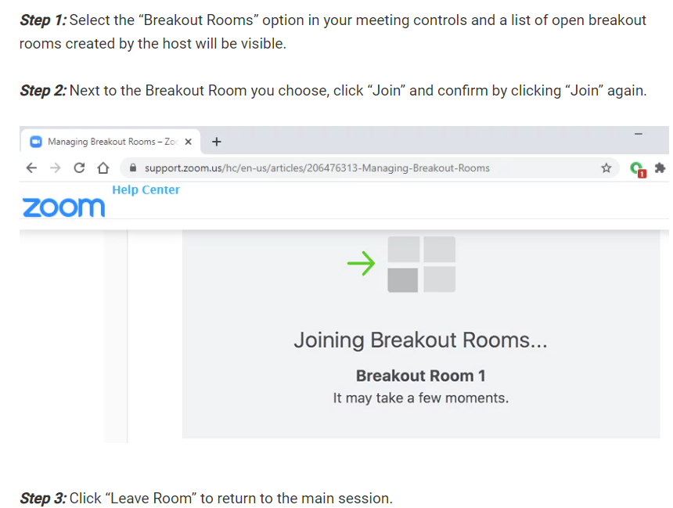
Self-Selecting a Breakout Room
Notes:
To join a breakout room if you have not been preassigned and nothing pops up, you go into the bottom meeting control bar, and select breakout rooms. Please select your region, or the one that fits you most closely, and click join. [Person] has also put the link to these directions in the chat.

Slide 91
Breakout Room #1
EXAMPLE
Was there anything in this material that was new to you or surprised you? Did anything stand out, and if so, in a positive or negative way?
What challenges do you foresee with HDs, CBOs, and providers taking on these roles in your specific region of [State]?
Was there anything you felt was missing from these roles that happens at your organization in response to outbreaks or clusters? If so, can you share with the group?
Aside from HDs, CBOs, and providers, how would you like to see others, i.e., community members, involved in CDR work?
What is one thing that you want to ensure the HD knows and can act on after this learning series concludes?
Notes:
NOTE: HD should change these questions to help garner the specific information you’re looking to learn from the participants.
These are the guiding questions that we’ve created, but they’re only meant to spur conversation, and your group is welcome to discuss anything that arose for you during this last section. Ultimately, the breakouts are an opportunity to connect with people from your region and brainstorm potential ideas/actions for moving forward. There will be ten-, five-, and one-minute warnings before the breakout room concludes. Thank you, and we’ll see everyone in about 35 minutes!
[cue breakout rooms]

Slide 92
5-MINUTE BREAK
Notes:
NOTE: HD should change these questions to help garner the specific information you’re looking to learn from the participants.
These are the guiding questions that we’ve created, but they’re only meant to spur conversation, and your group is welcome to discuss anything that arose for you during this last section. Ultimately, the breakouts are an opportunity to connect with people from your region and brainstorm potential ideas/actions for moving forward. There will be ten-, five-, and one-minute warnings before the breakout room concludes. Thank you, and we’ll see everyone in about 35 minutes!
[cue breakout rooms]

Slide 93
“Real World” Health Department Experiences with Cluster Response
Notes:
Welcome back from your breakout rooms and the break. I hope you had productive conversations.
In this section I am going to share HD experiences with detecting and responding to clusters and what they learned

Slide 94
Health Department Cluster Experience
PHILADELPHIA
Molecular cluster identified that included 15 persons
  Investigation found an additional 28 sexual contacts
  Efforts implemented included relinking people to care, conducting re-interview and identifying additional partners, and referring partners who are HIV negative to PrEP
DC, MARYLAND, VIRGINIA
Many molecular clusters involved persons from 2 or 3 of these jurisdictions
  Strengthened integration of response across three jurisdictions
Based on information in a slide presented by CDC
Notes:
This slide has examples of clusters from Philadelphia and the Metro DC area.
<CLICK>
In Philadelphia they had a molecular cluster that included 15 persons
<CLICK>
The Investigation found an additional 28 sexual contacts and
<CLICK>
The Efforts implemented included relinking people to care, conducting re-interviews and identifying additional partners, and referring partners who are HIV negative to PrEP services
<CLICK>
In the DC, Maryland, Virginia metropolitan area they have found that many molecular clusters involved persons from 2 or 3 of these jurisdictions
Investigating them Strengthened the integration of the health department response across three jurisdictions

Slide 95

Interventions Go Beyond the Individuals
Example: San Antonio, TX: large molecular cluster identified among Latino MSM
Investigation led to missed diagnosis of acute infection → health alert to providers educating on HIV diagnostic testing and acute infection
Investigation demonstrated a lack of access to PrEP → health alert educated on PrEP, funds redirected to scale up access in specific regions of the city
Findings led signing San Antonio on as a Fast-Track City → led to a new coalition of community, providers, and public health
https://www.cdc.gov/hiv/risk/prep/index.html
Notes:
This slide is an example of cluster response leading to interventions that go beyond the individuals involved in the cluster
It occurred in San Antonio where they identified a large molecular cluster among Latino men who have sex with other men
the investigation demonstrated situations in which improper testing led to missed diagnosis of acute infection →which led to a health alert to providers educating them on HIV diagnostic testing and acute infection
Acute infection is the earliest stage of HIV infection and is accompanied by very high viral loads
The Investigation demonstrated a lack of access to PrEP → which led to a health alert educating providers on PrEP and redirecting funds to scale up access in specific regions of the city
The Findings led to signing San Antonio on as a Fast-Track City which led to a new coalition of community, providers, and public health. Fast Track City is an international effort to end HIV as a public health threat by the year 2030.
Interestingly, following this outbreak the community came together to form The End Stigma End HIV Alliance of San Antonio. They are a collaboration of all the HIV and AIDS organizations in San Antonio that are committed to destigmatizing and ending the HIV epidemic. We will hear from them next week about the work that they are doing in this area.
~~~~~~~~~~
Reference, if needed- not meant to be read with the slide
Pre-exposure prophylaxis (or PrEP) is a way for people who do not have HIV but who are at very high risk of getting HIV to prevent HIV infection by taking a pill every day. When someone is exposed to HIV through sex or injection drug use, the medicines in PrEP can work to keep the virus from establishing a permanent infection.
When taken daily, PrEP is highly effective for preventing HIV. Studies have shown that PrEP reduces the risk of getting HIV from sex by about 99% when taken daily. Among people who inject drugs, PrEP reduces the risk of getting HIV by at least 74% when taken daily. PrEP is much less effective if it is not taken consistently.
https://www.cdc.gov/hiv/risk/prep/index.html

Slide 96
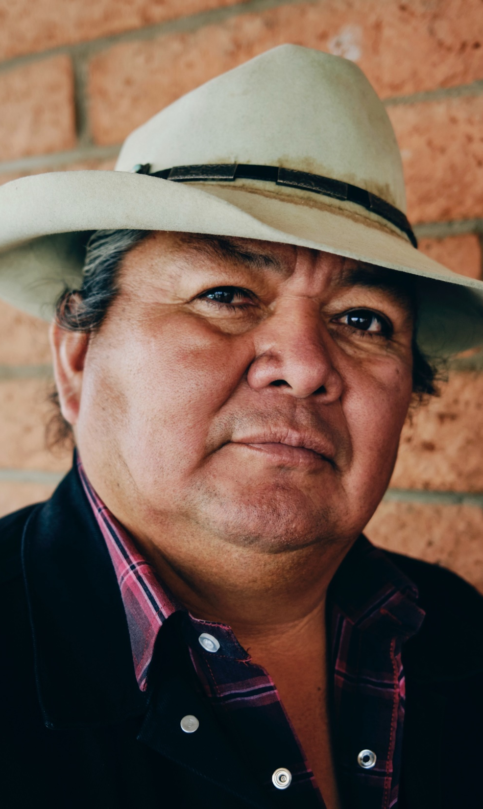
HD EXPERIENCE:
Paying Attention to Previously Less Visible Groups
Needs identified based on cluster response:
2019, HIV was diagnosed in three people screened at the Native American Community Clinic (NACC) in Minneapolis, Minnesota
Noted increase in HIV among persons who inject drugs
Nearly half of the diagnoses were among young Native Americans, who typically make up less than 5 percent of people with HIV diagnosed in Minnesota each year
“Native Americans don’t really show up in HIV data in our area, because the number of infections is so small compared with other groups,”
They tailored their response to the needs of this group
See https://www.cdc.gov/hiv/policies/cdr/spotlights/minnesota.html
Notes:
This slide shows an example of a state that identified the need to work with a group that high rates but smaller numbers of people with HIV.
In early 2019, HIV was diagnosed in three people screened at the Native American Community Clinic (NACC) in Minneapolis, Minnesota.
During the previous decade, the clinic had only seen a handful of clients with HIV – so discovering three new diagnoses in just a few months was noteworthy.
Later that same year, the Minnesota Department of Health (MDH) conducted an analysis showing that over the past nine months there had been 18 HIV diagnoses in Minneapolis and neighboring St. Paul among people who inject drugs, more than three times the total in a typical year.
This unusual increase prompted the state to initiate a cluster investigation.
Using tools including partner services interviews and expanded HIV testing within homeless encampments and at harm reduction clinics, health officials had uncovered 26 linked cases by early 2021. They found that nearly half of the diagnoses were among young Native Americans, who typically make up less than 5 percent of people with HIV diagnosed in Minnesota each year.
“Native Americans don’t really show up in HIV data in our area, because the number of infections is so small compared with other groups,” says Dr. Kari Rabie, NACC’s medical director. “So there hasn’t been a focused strategy to support them. This outbreak made their needs visible in a way we hadn’t seen before.”
Rabie notes that while rates of HIV have typically been low, the Native American community faces a host of health challenges rooted in historical trauma. And because community members are tightly interconnected, once HIV was introduced, it was easy for the virus to be transmitted, especially among people who inject drugs.
The HIV outbreak response in Minneapolis has underscored the importance of addressing social determinants of health. To meet the needs of its clients, the Native American Community Clinic (NACC) improved its capacity and now offers comprehensive, culturally affirming HIV care.
I recommend reading what they learned and how they responded by going to the HD Spotlight reference in the bottom of this slide

Slide 97
HD EXPERIENCE:
Staffing and Service Delivery
“
CHANGES TO STAFFING AND SERVICE DELIVERY
The individuals exposed to HIV identified via cluster response were highly vulnerable and presented with complex needs (homelessness, poverty, active drug use, transactional sex work, exposure to violence, food insecurity).
While these conditions may exist for other newly diagnosed and other HIV+ individuals, these vulnerabilities were particularly acute among those identified via cluster response activities.
We learned that any linkage service delivered by public health staff needed to anticipate these needs and be prepared to connect individuals not only to medical evaluation and treatment services, but to social supports and benefits advocacy.
“
—HIGH PREVALENCE STATE
Notes:
This slide shows an example of the experience a high prevalence state had with responding to the needs of the people identified as being part of the cluster, including the need to change staffing to ramp up service delivery
They reported that
“The individuals exposed to HIV identified via cluster response were highly vulnerable and presented with complex needs such as homelessness, poverty, active drug use, transactional sex work, exposure to violence, and food insecurity.
While these conditions may exist for other newly diagnosed and other HIV+ individuals, these vulnerabilities were particularly acute among those identified via cluster response activities.
We learned that any linkage service delivered by public health staff needed to anticipate these needs and be prepared to connect individuals not only to medical evaluation and treatment services, but to social supports and benefits advocacy.”

Slide 98


HD EXPERIENCE: SUCCESS STORIES
“Through one of our cluster investigation efforts, our [DIS] were able to get the names of over 150 partners. Over 1/3 of the named partners… were newly diagnosed as a result of field follow-up and partner service interviews.”
–HIGH PREVALENCE STATE
“Fifty-two persons were included in our cluster investigation (including named partners) with 21 confirmed HIV [diagnoses].
Two new diagnoses of HIV were made as a direct result of being contacted, interviewed
19 named partners were confirmed [not to have] HIV, of those, 11 were referred to, and confirmed to have accessed PrEP care services.
Seven previously diagnosed individuals became virally suppressed.”
—LOW PREVALENCE STATE
LEARNING SERIES: HIV CLUSTER RESPONSE
Notes:
This slide shows two examples of HD’s successfully intervening in a cluster:
<CLICK>
A High prevalence state reported that
“Through one of our cluster investigation efforts, our DIS were able to get the names of over 150 partners.
Over 1/3 of the named partners… were newly diagnosed as a result of field follow-up and partner service interviews”
<CLICK>
A Low prevalence state reported that
“Fifty-two persons were included in our cluster investigation (including named partners) with 21 confirmed HIV [diagnoses].
Two new diagnoses of HIV were made as a direct result of being contacted, interviewed
19 named partners were confirmed [not to have] HIV, of those, 11 were referred to, and confirmed to have accessed PrEP care services.
Seven previously diagnosed individuals became virally suppressed.”

Slide 99
Community Engagement
Notes:
Before our break, we discussed the integration of health department, providers and community-based organizations in responding to clusters
We momentarily mentioned community engagement, and in this Section, I want to dive into this topic more deeply. To minimize potential harms and maximize benefits, both robust data protection and community engagement are essential to successfully responding to a cluster.

Slide 100
Responding to an HIV Cluster
HIV PREVENTION & PARTNER SERVICES
COMMUNITY
HIV SURVEILLANCE DATA
HIV CARE
Notes:
Let’s look at this slide again and ask how we integrate community input into cluster response.
<CLICK>
This process is usually called community engagement and doing it well and consistently can help support the HDs successful response to a cluster, improve community and health department relationships and improve the health of the community

Slide 101



Who is “The Community”?
People living with or affected by HIV and their families:
Should reflect the local epidemiology and vary by:
Age, race, ethnicity, sex, gender identity, sexual orientation, class/income
Ideally have a range of backgrounds and experiences with HIV prevention and care services
Members of populations disproportionately affected by HIV
HIV service providers and other community-based organizations (CBOs).
Members of the public with an interest in HIV prevention and care
Photo credit: Building Healthy Online Communities’
Notes:
Who is The community?
The word means different things to different people and varies by context.
Generally included in this context are:
People living with or affected by HIV and their families:
Should reflect the local epidemiology and vary by:
Age, race, ethnicity, sex, gender identity, sexual orientation, class/income
Ideally having a range of backgrounds and experiences with HIV prevention and care services
<CLICK>
Members of populations disproportionately affected by HIV
HIV service providers and other community-based organizations (CBOs).
Members of the public with an interest in HIV prevention and care
Age is a characteristic that has not been sufficiently addressed in considering who should be involved in community engagement work and HDs should actively promote the inclusion of people in their 20s and early 30’s who can have a different opinion on HIV prevention work than those who are older and traditionally involved in working with health departments.
At a minimum, community members should reflect the epidemic in the area. The next few slides describe this.

Slide 102

What is Community Engagement?
There is no standard, commonly agreed upon definition of community engagement, but the World Health Organization provides a succinct description that is relevant in the context of HIV programming:
“a process by which people are enabled to become actively and genuinely involved in defining the issues of concern to them, in making decisions about factors that affect their lives, in formulating and implementing policies, in planning, developing, and delivering services, and in taking action to achieve change.”
From: National Minority AIDS Council. Expanding your Reach to End the HIV Epidemic: Community Engagement Toolkit. Available at: http://www.nmac.org/wp-content/uploads/2012/08/NMAC-Community-Engagement-Toolkit-Web.pdf
Notes:
So, what is community engagement?
There is no standard, commonly agreed upon definition, but the World Health Organization provides a succinct description that is relevant in the context of HIV programming: they describe it as quote
“a process by which people are enabled to become actively and genuinely involved in defining the issues of concern to them, in making decisions about factors that affect their lives, in formulating and implementing policies, in planning, developing, and delivering services, and in taking action to achieve change”
How do we accomplish what is in this definition? We start by defining “the community”

Slide 103
People Living with HIV, Texas (2019)
EXAMPLE
People Living with HIV in Texas by Sex, Race/Ethnicity, Age, and Risk 2019
 | Cases | % | Rate
Total | 97,844 | 100% | 337.4
Sex Assigned at Birth
Male | 77,364 | 79% | 537.1
Female | 20,480 | 21% | 140.3
Race/Ethnicity
White | 23,209 | 24% | 194.2
Black/African American | 35,834 | 37% | 1023.4
Hispanic/Latino | 33,530 | 34% | 290.9
Other/Multiple Races | 5,271 | 5% | 261.2
Current Age (as of 12/31/2019)
0-24 | 3,920 | 4% | 95.0
25-34 | 19,883 | 20% | 464.9
35-44 | 22,097 | 23% | 560.5
45-54 | 24,774 | 25% | 697.1
55-64 | 20,221 | 21% | 617.4
65+ | 6,949 | 7% | 186.1
Transmission Risk
MSM | 60,452 | 62% | ─
PWID | 8,642 | 9% | ─
MSM/PWID | 5,556 | 6% | ─
Sex with male/Sex with female | 22,190 | 23% | ─
Perinatal transmission | 908 | 1% | ─
Other adult risk | 96 | 0% | ─
TAKE HOME POINTS, RACIAL DISPARITIES:
Number of PLWH among Blacks is 1.5x as high as among Whites
Number of PLWH among Hispanics/Latinos is 1.4x as high as among Whites
Rates among Blacks are 5.3x as high as among Whites
Rates among Hispanics/Latinos are 1.5x as high as among Whites
Notes:
NOTE: Presenting jurisdictions can use this as a model for sharing key points about their jurisdiction’s identity-specific data and main takeaways/disparities within it.
This slide is an overview of the demographic characteristics of PLWH in [presenting jurisdiction and year]. Let me start by orienting you to the different columns in the table.
*INFORMATION BELOW MUST BE CHANGED TO REFLECT NUMBERS AND TRENDS IN THE PRESENTING JURISDICTION*
The reason I am showing this information to you is because community engagement participants should bear a resemblance to the populations affected by HIV. There are, of course, other considerations for who participates in community engagement work but, to be effective, this should certainly play a role.
<CLICK>
The first column has the categories we are using to describe PLWH in Texas, as you go down the first column: Sex assigned at birth, race/ethnicity, age, and transmission
<CLICK>
The second set of columns has three categories. First is cases- this is the number of people that fit into each row. For example, the total number of cases is 97, 844 people living with HIV in Texas in 2019. The second column is percentage of the total so, since the first row is the total, that’s 100%. The last column is rate.
The rate gives you an idea of how much what we are measuring (HIV infection in this table) impacts a specific population. <SLOW> It tells you how common or prevalent HIV infection is by various characteristics and is calculated by dividing the number of cases by the population. So, the same number of cases in a smaller population will give you a higher rate. For example, the 97,844 cases in Texas in 2019 gives you a rate of about 337 for every 100,00 people among it’s almost 30 million population. If that same number of cases (almost 98, 000) was present next door in the state of New Mexico, with a population of about 2 million the rate would be a lot higher- it would have a bigger impact. One way I think about what rate differences show is how concentrated something is in one population compared to another.
Now let’s look at the race/ethnicity category
<CLICK>
This green circle shows how the proportion, or percentage, of cases varies by race and ethnicity: white persons make up 24% of PLWH, black persons 37%, Hispanic persons 34%
But when you look at the rates
<CLICK>
in the red circle you see the racial and ethnic discrepancies. Among white people the rate is 194; among black persons 1023 and among the Hispanic/LatinX population 291.
<SLOW>
The reason why the rates among black people in Texas are so high compared to the Hispanic rate (they are 3.5 times higher) when
<CLICK>
the number of cases is about the same, at 33-35 thousand in these two groups, is because there are fewer black than Hispanic people living in the state. When it is spread out in the smaller black population the rate is higher.
Before showing you some of this information by region, let’s review the take home points about racial and ethnic disparities.
<CLICK>
<SLOW> If you compare HIV in the black and Hispanic populations to the white population, and, not to each other as I just discussed, you see:
That in the first column under cases the Number of PLWH among Blacks is 1.5x as high as among Whites, almost 36,000 compared to about 23 thousand.
<CLICK>
The Number of cases among Hispanics/Latinos is 1.4x as high as among Whites
<CLICK>
While Rates, that take population into account, show that HIV among Blacks is 5.3x as concentrated as among Whites
<CLICK>
And Rates among Hispanics/Latinos are 1.5x as concentrated as among Whites
~~~~~~~~~~~~~~~~~~~~~
From https://data.census.gov/cedsci/profile?g=0400000US48
For comparison:
Total pop of Texas 28,995,881 adds to 100%+ because of the ethnicity issue
Hisp of any race 11,511,365 39.7%
Black, non-Hisp 3,566,493 12.3%
White, non-Hisp 21,282,977 73.4%
Other, non-Hisp
(includes multi-racial) 4,175,407 14.4%

Slide 104
PLWH, Urban/Border/Rural (2019)
EXAMPLE
 | Urban |  |  | Border |  |  | Rural
 | Cases | % | Rate* | Cases | % | Rate* | Cases | % | Rate*
Total | 84,552 | 100% | 359.7 | 5,572 | 100% | 201.6 | 3551 | 100% | 129
Sex Assigned at Birth
Male | 66,328 | 78% | 569.5 | 4665 | 84% | 340.8 | 2555 | 72% | 182.1
Female | 18,224 | 22% | 153.6 | 907 | 16% | 65 | 996 | 8% | 73.8
Race/Ethnicity
White | 20769 | 25% | 206.6 | 321 | 6% | 134.6 | 1446 | 41% | 86.6
Black/African American | 33050 | 39% | 1022.1 | 136 | 2% | 374.8 | 1041 | 29% | 448.8
Hispanic/Latino | 25860 | 31% | 310.9 | 5062 | 91% | 206.8 | 860 | 24% | 110.4
Other/Multiple Races | 4873 | 6% | 256 | 53 | 1% | 127 | 204 | 6% | 277.9
Number of PLWH among Blacks compared to Whites
Urban: 1.6x
Number of PLWH among Hispanics/Latinos compared to Whites
Urban: 1.2x
Border: 15.8x
Rates among Blacks compared to Whites
Urban: 4.9x
Border: 2.8x
Rural: 5.2x
Rates among Hispanics/Latinos compared to Whites
Urban 1.5x
Border: 1.5x
Rural: 1.3x
Notes:
NOTE: Presenting jurisdictions can use this as a model for sharing key points about their jurisdiction’s identity-specific data and main takeaways/disparities within it.
Looking at the regions throughout the state, you can see that these racial disparities also occur in your urban, border, and rural regions.
<CLICK>
The GREEN CIRCLES show the % of cases by race and ethnicity in each region
--Briefly, in the urban area the number of cases are mostly in the black and Hispanic population but, compared to the next two regions, there is still a considerable number, shown by the percentages among the white population
--In the border area the cases are heavily concentrated in the Hispanic population at 91%
--In the rural area, while the majority of cases are in the white population at 41%, it is much less than what you saw for Hispanics in the Border region.
<CLICK>
The comparisons are shown here
<CLICK>
The rates, which are the number of cases per 100,000 people, shown in the RED CIRCLES underscore the discrepancy I just discussed on the previous slide.
<CLICK>
And are listed more specifically here.
<CLICK>
Interestingly we see the difference between black and white persons are more stark in all three regions (4.9 in the urban areas) compared to
<CLICK>
the differences between Hispanic and white populations (all between 1 and 2x as high).
I know that there is a lot of information in these slides that you may want to look at more leisurely so we will make them available to you.
~~~~~~~~~~~~~~~~
Urban:
Number of PLWH among Blacks is 1.6x as high as among Whites
Number of PLWH among Hispanics/Latinos is 1.2x as high as among Whites
Rates among Blacks are 4.9x as high as among Whites
Rates among Hispanics/Latinos are 1.5x as high as among Whites
Border:
Number of PLWH among Hispanics/Latinos is 15.8x as high as among Whites
Rates among Blacks are 2.8x as high as among Whites
Rates among Hispanics/Latinos are 1.5x as high as among Whites
Rural:
Rates among Blacks are 5.2x as high as among Whites
Rates among Hispanics/Latinos are 1.3x as high as among Whites

Slide 105
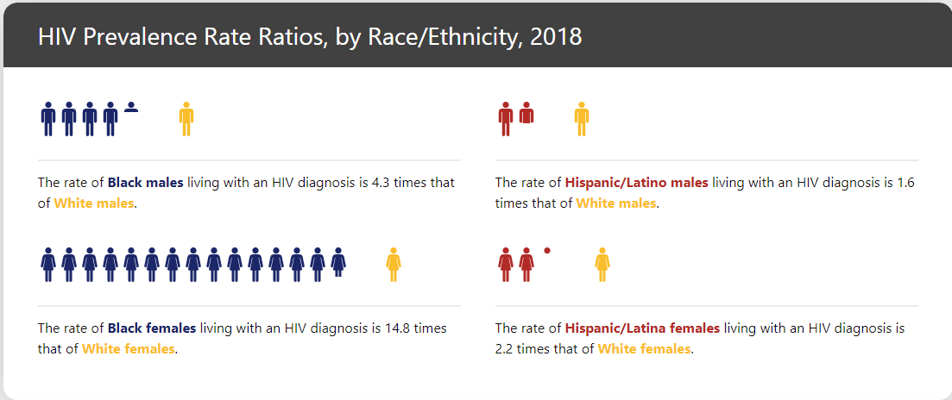

Racial/Ethnic Disparities Among PLWH, Texas (2018)
EXAMPLE
Notes:
NOTE: Presenting jurisdictions can use this as a model for sharing key points about their jurisdiction’s identity-specific data and main takeaways/disparities within it. For future slides, we recommend using alternate visuals, as showing part of a person can be dehumanizing. Lastly, this is an example slide from the past, but we advise your HD to not show part of a person on your future visuals, as it can be dehumanizing.
Before going back to a discussion of community engagement, I find that the proverbial picture is worth a thousand words, and I think differences by sex should also be considered.
This slide illustrates racial discrepancies by sex in Texas, comparing black and Hispanic/Latinx males and females to whites.
<CLICK>
It is from the AIDSVu website, noted in the green circle, which you might find interesting to explore. It is very visual with maps that can show the different characteristics you might be interested in including those specific for the cities of Fort Worth, Dallas, Houston, San Antonio, and Austin as well as the counties surrounding them.
Now, back to what this slides show us. The first row in this slide shows racial discrepancies for males.
<CLICK>
The rate among black males living with an HIV diagnosis is 4.3 times that of white males. For Hispanic males it is 1.6 times.
In the second row you see one of the largest racial discrepancies and they are reflected in the admittedly heavily gendered stick figures. (My apologies for that)
<CLICK>
The rate of black females living with an HIV diagnosis is 14.8 times that of white females. Among Hispanics it is 2.2 times that of white females. I will say that I see this pattern among black women so disproportionately impacted by HIV in many states and localities. It isn’t unique to this area and something that has needed, and continues to need, attention to change it.
For community engagement what this means is that you want to make sure that you have black and Hispanic males and females involved in the discussion. And, as I brought up a few slides ago I strongly encourage you to reach out to people of varying ages and experiences

Slide 106

COMMUNITY ENGAGEMENT:
HIV Community Networks
Who should pick participants in community engagement activities?
People living with or affected by HIV and their families
Networks of people living with HIV should pick their representatives
The Sero Project’s Network Empowerment Project includes a list of networks in the U.S
Notes:
Who should pick participants in community engagement activities?
Generally, it is best for
People living with or affected by HIV and their families to decide who should represent them.
You might want to start by contacting
Networks of people living with HIV.
One place to start is
The Sero Project’s Network Empowerment Project which includes a list of networks in the U.S
If that doesn’t help or you want more diversity, start with those you know but then use your contacts to expand out to get diversity so the people providing input quote unquote “look like” the epidemic in your area.

Slide 107

COMMUNITY ENGAGEMENT:
Process and Benefits
Input sought at the beginning and throughout program development, rollout, and evaluation
Engagement: implies an ongoing activity
Promote an active listening process
More effective and faster program implementation
More comprehensive insight into the benefits and risks of the program
Strengthens understanding of health department and community roles and responsibilities
Notes:
What is the process and what are some of the benefits of engaging with the community?
<CLICK>
Input should be sought at the beginning and throughout program development, rollout, and evaluation
The word Engagement implies an ongoing activity
It is best to Promote an active listening process
<CLICK>
Potential benefits for the cluster detection and response program include:
More effective and faster program implementation
<CLICK>
More comprehensive insight into the benefits and risks of the program
<CLICK>
And it strengthens understanding of health department and community roles and responsibilities

Slide 108

COMMUNITY ENGAGEMENT PROCESS: [presenting jurisdiction]
EXAMPLE
Health Department had community meeting to obtain support prior to applying for demonstration project (CDC PS17-1711)
Texas worked with the HIV Syndicate to implement Project Conectate (CDC PS17-1711)
Held community forum specific to cluster detection and response (September 2017)
Multiple presentations to planning groups
Created materials for provider and community distribution to raise awareness of cluster detection and response
Notes:
NOTE: Presenting jurisdictions can use this as a model for presenting information about their jurisdiction’s community engagement work thus far. This is an example slide with another jurisdiction’s information. Do not present this content.
I’d like to spend a minute on the community engagement process for cluster detection and response in [insert jurisdiction].
The Texas Department of State Health Services had a community meeting to obtain support prior to applying for a demonstration project (CDC PS 17-1711) which provides funding for using molecular HIV surveillance data to identify active HIV transmission networks and implement HIV interventions for Hispanic/Latino men who have sex with men. It’s called Project Conectate and we’ll hear more about it from the HD during Part 3, a week from today.
Texas worked with the HIV Syndicate to implement Project Conectate
They held a community forum specific to cluster detection and response in the Summer of 2017 when the project was just getting started
they made Multiple presentations to planning groups and
In coordination with the Syndicate, created materials for provider and community distribution to raise awareness of cluster detection and response

Slide 109
CLUSTER RESPONSE:
Potential Benefits
More effectively prevent transmission by focusing prevention resources where they are most needed
More quickly diagnose HIV and bring people into care
Potential to more effectively and efficiently target existing core services to people who are part of a network of rapid transmission:
HIV testing, including venue-based
Partner services
Linkage and re-linkage to HIV medical care
PrEP referral
Health departments report that most people welcome the support for linkage to testing, care and other support services
Notes:
Potential benefits to the outcome of the cluster work include
<CLICK>
More effectively preventing transmission by focusing prevention resources where they are most needed"
<CLICK>
More quickly diagnose HIV and bring people into care
<CLICK>
the Potential to more effectively and efficiently target existing core services to people who are part of a network of rapid transmission: those services include
HIV testing, including venue-based
Partner services
Linkage and re-linkage to HIV medical care and
PrEP referral
<CLICK>
Health departments report that most people welcome the support for linkage to testing, care and other support services

Slide 110
HD EXPERIENCE:
Incorporating Community Input
“
“…our initial plan (as DPH) was to deploy a mobile testing van to a location near homeless camps, where we had epidemiologic evidence [people living with HIV] and at-risk individuals linked to the cluster resided. We learned from our stakeholder engagements that deployment of an unfamiliar medical van to that location would actually be likely to frighten those individuals and drive them ‘underground.’
As a result, we worked with an existing, trusted team of outreach workers, who allowed DPH and testing and linkage staff to accompany them to engage individuals directly. This proved highly successful and word quickly spread that new staff in the area could be trusted.
The hard part here is, in an outbreak, the instinct is to move quickly, but in truth it is far more beneficial to plan in advance as much as possible and check in with community experts first before deploying any interventions.”
“
—HIGH PREVALENCE STATE
Notes:
This slide shows an example of how a high prevalence state improved their response by incorporating feedback from the community. It includes some of the benefits I was just discussing.
They reported that:
<CLICK>
“…our initial plan (as the department of public health) was to deploy a mobile testing van to a location near homeless camps, where we had epidemiologic evidence HIV+ and at-risk individuals linked to the cluster resided. We learned from our stakeholder engagements that deployment of an unfamiliar medical van to that location would actually be likely to frighten those individuals and drive them ‘underground.’
<CLICK>
As a result, we worked with an existing, trusted team of outreach workers, who allowed DPH and testing and linkage staff to accompany them to engage individuals directly. This proved highly successful and word quickly spread that new staff in the area could be trusted.
<CLICK>
I want to emphasize this last part:
SLOW
The hard part here is, in an outbreak, the instinct is to move quickly, but in truth it is far more beneficial to plan in advance as much as possible and check in with community experts first before deploying any interventions.”

Slide 111

CLUSTER RESPONSE:
Potential Harms
If done without community support could lead to resentment and avoidance of health department staff and programs
Increased stigmatization of groups or people associated with those groups
Criminalization of PLWH
Possibility of surveillance information being subpoenaed
Additional harm among those most vulnerable: people of color, LGBTQ youth, transgender persons
Notes:
There are also potential harms to responding to clusters
If done without community support this work could lead to resentment and avoidance of health department staff and programs that help people improve their health
<CLICK>
There is concern about Increased stigmatization of groups or people associated with those groups
<CLICK>
And The concern about Criminalization of PLWH needs to be addressed, especially
The possibility of surveillance information being subpoenaed
And there is concern about Additional harm among those most vulnerable: people of color, LGBTQ youth, and transgender persons of any age

Slide 112

COMMUNITY CONCERNS:
Distrust
Concerns about consent
Increased mistrust between community members especially in communities of color, and the medical and public health communities
Concern that information from cluster investigations could be used to prosecute PLWH
Laws and practices not consistent with current science
HIV-specific criminalization statutes
Using HIV status to enhance sentencing even in the absence of HIV-specific laws
For more information see: https://www.cdc.gov/hiv/policies/law/states/exposure.html
Notes:
These next few slides discuss experiences we have had working with the community and includes health department experiences as well.
<CLICK>
There is distrust; including
Concern about consent – guidance from CDC has stated that consent is not needed for cluster detection using genetic sequence data because resistance testing is done as a part of the standard of care. <SLOW> However, this particular use of the genotypes that are generated during resistance testing is not part of selecting the best medication for the individual so this can sound like a justification rather than an explanation. This is one of the ongoing ethics concerns and conversations related to cluster detection and response.
<CLICK>
There is Increased mistrust between community members especially in communities of color, and the medical and public health communities
<CLICK>
Along with Concern that information from cluster investigations could be used to prosecute PLWH
<CLICK>
We are doing this work nationally in the context of Outdated laws and practices, specifically
HIV-specific criminalization statutes AND
Using HIV status to enhance sentencing even in the absence of HIV-specific laws
We will be discussing the issue of HIV related laws in [insert jurisdiction] in Part 3.

Slide 113

COMMUNITY CONCERNS:
Effectiveness
Communities question the benefits of cluster detection and response:
Have they interrupted rapid transmission?
Have they found undiagnosed persons? Linked people to care? To PrEP?
Provided services to people in a cluster who did not have them?
Any cost benefit analysis, or any evidence that CDR is better than/different from field staff doing regular DIS field activities?
Health departments should track these outcomes to measure effectiveness
As a newer health department activity, lack of rigorous national evaluation on outcomes and effectiveness of cluster detection and response
Notes:
Some community members and others question the effectiveness of cluster detection and response: Questions that came up in interviews with community members about these health department activities include:
Have they interrupted rapid transmission?
Have they found undiagnosed persons? Has the HD Linked people to care? To PrEP?
Have they Provided services to people in a cluster who did not have them?
Has there been Any cost benefit analysis, or any evidence that cluster detection and response is better than or different from field staff doing regular DIS field activities?
<CLICK>
These are essential questions, and we recommend that Health departments track these outcomes to measure effectiveness of this work
<CLICK>
As a relatively newer health department activity, the lack of rigorous national evaluation on outcomes and effectiveness of cluster detection and response can undermine this work

Slide 114

COMMUNITY CONCERNS:
Possible Ways Forward
Explore difference between cluster detection and response and routine follow-up by the health department
Address specific concerns of the priority populations/communities
Hire members of the community to do the contacting with members of the cluster(s)
Have concerns changed since the beginning of the pandemic?
More/fewer requests for linkage to care?
Less trust in the health department?
Use people-first language
Use plain language
Train field staff on language
Notes:
So, how do we move forward? How do we accomplish what is in the definition of community engagement that I presented at the beginning of this section of today’s webinar?
We offer these thoughts:
Explore with the community the difference between cluster detection and response and routine follow-up by the health department to better understand concerns
LISTEN and BELIEVE what people say about their experiences and concerns
<CLICK>
Address specific concerns of the various communities (e.g., immigration for Latinx communities)
E.g., for Latinx populations, hire members of the community, including those who are bilingual, to do the contacting with members of the cluster(s);
Look into whether concerns have changed since the beginning of the pandemic
Are there more or fewer requests for assistance with linkage to care?
Is there Less trust in the health department?
Take into account and act on what you hear in response to these questions.
<CLICK>
Use people first language (an example of this is saying a person living with HIV instead of an HIV-infected person)
Use plain language
Train field staff on language and the importance of listening

Slide 115
Community Engagement/Data Protection Considerations
INITIAL ACTIVITIES
Ongoing community engagement
Recognize and address stigma
Ensure data are protected
Assess/change criminal exposure laws
TYPICAL EPIDEMIOLOGIC TERMS ARE HEARD AS DEHUMANIZING
Calling people “cases,” “infections,” or “clusters”
Explore language used to describe the process
Notes:
Before we go into an activity where we can discuss this topic in breakout rooms, I want to summarize the issues around community engagement as well as protecting the data
Initial Activities should start a process for
Ongoing community engagement including
Recognize and Address stigma, which we will discuss next week during Part 3 of this series
Ensure that the data are protected
Assess criminal exposure laws; discuss how to change them and include the community in that process
Typical epidemiologic terms may be heard as dehumanizing, for example:
Calling people “cases,” “infections,” or “clusters”
Explore language used to describe the process
To underscore this point, in October 2020 the entire issue of the American Journal of Bioethics was dedicated to community concerns with CDR. The lead editorial is titled “We Are People, Not Clusters”
I’d like to note here something about listening to community members. <SLOW> These concerns need to be heard and not just retorted. It can be common for HD staff to go into these discussions thinking "how can I convince the community to support this? How can I explain this so they will work with us?" It is natural, but I encourage you to, instead, go into these sessions from the perspective "I am here to listen and learn." Consider practicing conversations beforehand if you think you would find that helpful.
And for community members who disagree with each other, the same advice holds -- listening to and learning with each other.

Slide 116
Breakout Room #2
Notes:
NOTE: The addition and timing of breakout rooms are up to the presenting jurisdiction. We’re going to split into breakout rooms by [region, role, organization, etc.] now so you can process and discuss everything we just shared. If you aren’t placed into a breakout room, there will be a box that pops up on the bottom-middle area of your screen asking you to choose a room. Please choose the group that categorizes you best. The breakout rooms will be for half an hour, and there will ten-, five-, and one-minute warning before they finish. These breakout rooms will not be recorded, and each room will have a facilitator and a note taker.

Slide 117
Self-Selecting a Breakout Room
Notes:
Again, to join a breakout room if you have not been preassigned and nothing pops up, you go into the bottom meeting control bar, and select breakout rooms.

Slide 118
Breakout Room Questions
EXAMPLE
Given some of the community concerns you heard in this presentation, what are some actions that health departments can take in the future to address these concerns?
In what way(s) would it be most helpful to be in contact with the health department surrounding CDR work?
Are there other community concerns specific to your region that we have missed here? If so, what else would be helpful for the partners we’ve been discussing (health departments, CBOs, providers etc.) to know?
What is one thing that you want to ensure [insert HD name] knows and can act on after this learning series concludes?
Notes:
These are the guiding questions that we’ve created, but they’re only meant to spur conversation, and your group is welcome to discuss anything that arose for you during this last section. Ultimately, the breakouts are an opportunity to connect with people from your region and brainstorm potential ideas/actions for moving forward. Thank you, and we’ll see everyone in about 30 minutes!
[cue breakout rooms]

Slide 119
Logistics Questions [Virtual]
Notes:
Hi everyone, I hope your second breakout room was impactful! Before we close today’s webinar, I wanted to see if anyone has remaining logistics questions. Please unmute yourself and share your name, pronouns, and role before you ask a question, or you can put your question in the chat.

Slide 120
Thank You
FOR QUESTIONS CONTACT
Name
Title
Email
Phone
Notes:
NOTE: The presenting jurisdiction can insert their desired contacts’ information on this slide.
As a reminder, the third and final part of this series is [insert date time and reminder info]

Slide 121
LEARNING SERIES
HIV Cluster Response
Health Department, Provider, and Community Collaboration to RESPOND to HIV Clusters
PART 3
Notes:
Hello everyone, and welcome to the Part 3 of the Learning Series: HIV Cluster Response: Addressing Community Concerns: Data Release and HIV Criminalization Considerations & HIV Stigma. We’re excited to have you all here again!

Slide 122
Expectations and Logistics
[VIRTUAL]
Participation
Participants will be muted to limit background noise, but you may unmute yourself during discussion or Q&A if you want to talk
Will have some interactive components during the webinar
Asking questions
Please submit questions in the chat box and/or can ask verbal questions during Q&A times
Maintaining a safe space for discussion
Webinar will be recorded for internal reference
For IT issues: please email: [insert contact email]
Notes:
Before we get started, I want to quickly go over expectations and logistics again. As a reminder, please stay muted while the speakers are presenting, but feel free to unmute yourself during discussion and Q+A sections if you want to speak. Please introduce yourself with your pronouns before you make a comment or ask a question. You can also submit questions/comments in the chat box outside of designated Q+A or discussion time.

Slide 123
Learning Series
PART 1
Public Health Surveillance Basics & Using Surveillance Data to Detect HIV Clusters
PART 2
Health Department, Provider, and Community Collaboration to Respond to HIV Clusters
PART 3
Addressing Community Concerns: Data Release and HIV Criminalization Considerations & HIV Stigma
Notes:
NOTE: Insert jurisdiction-specific dates to this slide.
This presentation is Part 3 of a three-part learning series for health department staff and partners at Community-Based Organizations. Each day is a blend of presentation slides and interactive discussion-based components.
Today we will hear from the [State/City] Health Department, discuss policy issues around the implementation of HIV cluster response, and focus on stigma in HIV cluster detection and response.

Slide 124
Three-Part Learning Series Objectives
Understand the history and concepts behind public health surveillance including ethics, consent, and data protection for HIV surveillance data
Explain the basic process, benefits, and drawbacks of HIV cluster response
Effectively communicate with community members/clients/patients about common cluster response concerns
Notes:
NOTE: Please alter these objectives based on the specific takeaways that you hope for the participants to gain.

Slide 125
Objectives for Today
Learn about how [jurisdiction’s name] is implementing cluster detection and response
Explain common data privacy concerns related to health department HIV data
Gain an overview of HIV data release statutes and related laws in [jurisdiction name]
Consider ways to approach HIV cluster detection without compounding stigma
Notes:
NOTE: Please alter these objectives based on the specific takeaways that you hope for the participants to gain.

Slide 126
Agenda for Today
[Jurisdiction’s] Cluster Response Overview
Policy/Legal Considerations: Data Release
HIV Cluster Response and Stigma
Community Speaker Section
Wrap Up
Notes:
This is our agenda for the day. We will have mentimeter activities after the first and second sections.

Slide 127
[Insert HD Name]’s
Cluster Response Overview
Notes:
NOTE: This slide is a placeholder for a health department staff member to make a brief presentation about their jurisdiction's specific CDR efforts and outcomes thus far.

Slide 128
ACTIVITY
When health departments reach out to people who are part of an HIV cluster, should the HD tell them that they were identified as part of a cluster?
Under what circumstances do you think health departments should tell people that they are part of a cluster?
Go to a browser and enter menti.com
Enter the number on your screen
Notes:
NOTE: We found this mentimeter gathered important responses, and we recommend that the presenting HD asks this question, too.
We’re going to do a quick mentimeter to gather your thoughts on whether or not to notify individuals if they are part of a cluster. Please pull up menti.com on a separate browser. There will be one multiple choice question to answer, and one open-ended one. This information will be helpful for the health department.
When health departments reach out to people who are part of an HIV cluster, should the HD tell them that they were identified as part of a cluster?
-Yes; Sometimes, it depends on the situation; Not sure, No
Under what circumstances do you think health departments should tell people that they are part of a cluster?
→Review what’s reported in the mentimeter and encourage discussion of anything that they see or additional thoughts or ideas.

Slide 129
Policy/Legal Considerations: Data Release
Notes:
NOTE: In this section, the presenting jurisdiction should populate the slides with state-specific HIV criminalization information. We suggest that health department staff have their legal counsel revamp and present these slides based on their specific state laws, or at least provide guidance for this section. A good website to use for populating these next slides with state-specific information is hivlawandpolicy.org

Slide 130
Topics
HIV criminalization background
[State/Locality] laws related to release of health department data (including HIV testing data)
Implications for genetic sequence data
Data protections

Slide 131

Community, Health Department, and Provider Legal Concerns
Disclosure of medical information, HIV status, or HIV testing to:
Family and friends
Employers
Landlords
Disclosure of connection to others in a cluster
Disclosure of HIV status to sex and needle-sharing partners
Potential request/release of data to law enforcement or legal system
Notes:
Some concerns include:
Disclosure of medical information, HIV status, or HIV testing to:
Family and friends
Employers
Landlords
Disclosure of connection to others in a cluster
Disclosure of HIV status to sex and needle-sharing partners
Potential request/release of data to law enforcement or legal system

Slide 132

HIV Criminalization in Texas
EXAMPLE
Texas repealed its HIV-specific criminal transmission statute in 1994
There are no public health laws criminalizing exposure to or transmission of HIV
PLWH may still be prosecuted under general criminal laws
Aggravated assault – 2nd degree felony, up to 20 years in prison
HIV status may be considered in sentencing
“potential long-term effect of injury”
Notes:
NOTE: In this section, both the notes and slides are samples from a previous NASTAD-led webinar series for Texas. The presenting jurisdiction needs to populate the slides with state-specific HIV criminalization information and edit the notes to match, too.
Texas has not had an HIV-specific criminal statute since 1994 and there are no public health laws criminalizing exposure to or transmission of HIV in Texas.
However,
[CLICK]
PLWH may still be prosecuted under general criminal laws, such as the aggravated assault statute, and HIV status can be considered in sentencing.

Slide 133
CASE LAW:
HIV Criminalization in Texas
EXAMPLE
Seminal fluid of PLWH may constitute deadly weapon to support conviction for aggravated assault, regardless of viral load or transmission risk. Mathonican v. State, 194 S.W.3d 59 (Tex. App. 2006).
HIV status is a “viable concern” and may be considered by the jury as a potential “long-term effect of the injury” in sentencing for aggravated assault. Suarez v. State, No. 14-03-00441-CR, 2004 WL 1660938 (Tex. App. July 27, 2004).
HIV status reflects the “defendant’s personal responsibility and moral guilt” and may be considered in sentencing. Martinez v. State, No. 05-03-01243-CR, 2004 WL 2378359 (Tex. App. Oct. 25, 2004).
Notes:
NOTE: In this section, both the notes and slides are samples from a previous NASTAD-led webinar series for Texas. The presenting jurisdiction needs to populate the slides with state-specific HIV criminalization information and edit the notes to match, too.
Courts in Texas have found that seminal fluid of a PLWH may constitute a deadly weapon in aggravated assault and aggravated sexual assault statutes. The defendant in the case cited here was sentenced to 97 years imprisonment for sexual assault, and the court found that their seminal fluid was a deadly weapon because of their HIV status. In 2014, the court followed this case and found that a PLWH can be convicted of aggravated sexual assault if they anally penetrate a partner, even if they do not actually ejaculate, regardless of their viral load or the level of transmission risk.
[CLICK]
Courts have also found that evidence of HIV status can be considered by a jury in sentencing, because it speaks to the impact on the victim of the crime. It’s unclear what the defendant’s sentence would have been without this evidence, but in the end he was sentenced to 15 years, which is on the lower end for a first degree felony which carries a sentence of anywhere from 5 years to life, and was not eligible for probation.
[CLICK]
And in another case, the court similarly found that evidence of HIV status is relevant at sentencing because it goes to the defendant’s personal responsibility and moral guilt.
Both of these two sentencing cases were for aggravated sexual assault of a child.
Note: In several of the cases in the example, transmission did not occur, which is important in a court case.

Slide 134
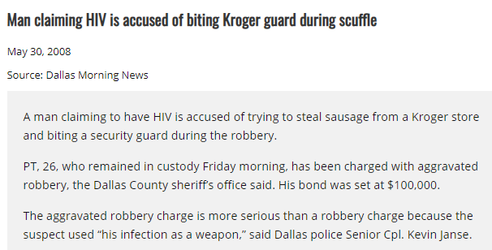

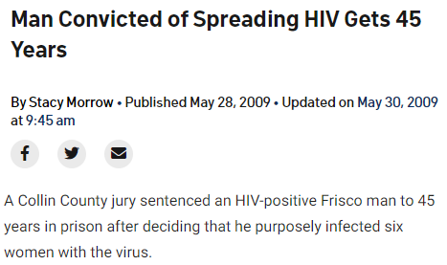

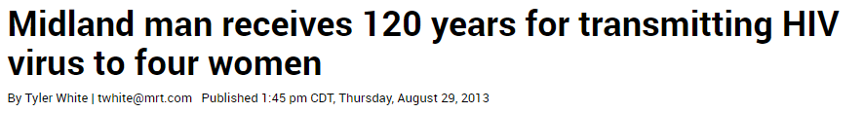

IN THE NEWS:
HIV Criminalization in Texas
EXAMPLE
Notes:
NOTE: In this section, both the notes and slides are samples from a previous NASTAD-led webinar series for Texas. The presenting jurisdiction should populate the slides with state-specific HIV criminalization information and edit the notes to match, too.

Slide 135
NATIONAL LANDSCAPE:
Data Release for Law Enforcement is an Exception to Confidentiality
EXAMPLE
HIV Confidentiality Statutes: Prohibit Release of HIV Data without Consent
EXCEPT
For adjudication of criminal or
civil matter
To respond to a public health emergency
To enforce public health laws
In response to a court order or subpoena (broad authority)
Some state statutes explicitly prohibit the release of any data for law enforcement purposes, which is the most protective approach. However, most state statutes compel the release for law enforcement in some circumstances.
Notes:
NOTE: In this section, both the notes and slides are samples from a previous NASTAD-led webinar series for Texas. The presenting jurisdiction needs to populate the slides with state-specific HIV criminalization information and edit the notes to match, too.
This is an overview of how HIV data laws are structured. I highlighted the two that come up in [x state’s] laws. I thought it might be helpful to frame this in contrast to what we see in many other states, to add some context.

Slide 136
5-MINUTE BREAK

Slide 137
State Laws
Notes:
The next slides cover the specific [state]-specific laws that address the confidentiality of health department data.

Slide 138

Disclosure of HD Communicable Disease Data
EXAMPLE
DISCLOSURE TO FEDERAL, COUNTY, OR DISTRICT COURTS:
Purpose for disclosure: Compliance with statutes and regulations relating to the control and treatment of communicable diseases, or under another law that expressly authorizes disclosure.
Types of data that may be released: Medical and epidemiological information, including information linking a person who is exposed to a person with a communicable disease, concerning any reportable disease.
Tex. Health & Safety Code Ann. § 81.046(c)(3)
Notes:
NOTE: In this section, both the notes and slides are samples from a previous NASTAD-led webinar series for Texas. The presenting jurisdiction needs to populate the slides with state-specific HIV criminalization information and edit the notes to match, too.
Generally speaking, state and local health department and health district records are confidential and cannot be released or made public, even with a subpoena.
But there are some exceptions.
[CLICK]
One exception allows health department data to be disclosed to federal, county or district courts for the purposes of complying with laws related to the control and treatment of communicable diseases, which typically refers to quarantine orders, court-ordered testing, orders for management of a person with a communicable disease (Tex. Health & Safety Code Ann. § 81.151) and things of that nature.
It also vaguely makes room for disclosure under another law that expressly authorizes disclosure.
So, the law does not expressly allow disclosure in connection with criminal matters, other than violations of control measures that could result in criminal penalties, but does leave the door open for disclosure under another law.
As of right now, I’m not aware of another existing law that would authorize disclosure to a court for prosecutorial purposes. I have not found any case law talking about disclosure in connection with criminal matters. That alone does not mean it can’t happen, it just means it’s never been raised as an issue at trial, but based on the totality of the current laws I don’t see a path for that kind of disclosure. In the cases I discussed a few slides ago, the evidence of HIV status was obtained through non-health department sources.
[CLICK]
The type of data that can be released is fairly broad, and includes and medical or epidemiological information linking a person who is exposed to another person with a communicable disease. As written, this law could potentially apply to cluster data. However, in my conversations with DSHS, they indicated that surveillance data cannot be released to law enforcement and they were unable to identify any instances of release of surveillance data to law enforcement or prosecutors.

Slide 139

Disclosure of HD Communicable Disease Data
EXAMPLE
DISCLOSURE TO LAW ENFORCEMENT AND FIRST RESPONDERS DURING PUBLIC HEALTH DISASTER, INCLUDING DISEASE OUTBREAK:
Purpose for disclosure: Protecting the health or life of a first responder or the person identified in the information disclosed.
Types of data that may be released: All information relating to cases or suspected cases of reportable diseases and health conditions.
Only the minimum necessary information may be released, as determined by the health authority or state/local health department.
Texas Health & Safety Code Ann. § 81.046(f)
Notes:
NOTE: In this section, both the notes and slides are samples from a previous NASTAD-led webinar series for Texas. The presenting jurisdiction needs to populate the slides with state-specific HIV criminalization information and edit the notes to match, too.
HD data can also be disclosed to law enforcement during a public health disaster, including disease outbreak.
[CLICK]
But the purpose for the disclosure is narrow—protection of the health or life of a first responder or the person identified in the data. So, criminal prosecution is pretty clearly outside of this scope.
[CLICK]
Although the type of data that can be released is fairly broad, the release itself is limited to the minimum information need to protect the health or life of the first responder or person identified in the data. And the HD gets to decide what that includes.
Again, DSHS has indicated that it operates under a principle of limited release – that is, the HD’s interpretation of the law is that surveillance data cannot be released to law enforcement, and DSHS has not identified any instances when such data has been released to law enforcement.

Slide 140
Disclosure of HD Communicable Disease Data
EXAMPLE
Confidentiality law does not specify whether a court order or subpoena is required for disclosure.
Judge may issue protective order or limit disclosure before information is entered into evidence or otherwise disclosed in court proceeding.
Health department staff may not be examined in a civil, criminal, special, or other proceeding as to the existence or contents of records, report, or other information about a person examined or treated for a reportable disease by a health department without that person's consent.
Tex. Health & Safety Code Ann. § 81.046
Notes:
NOTE: In this section, both the notes and slides are samples from a previous NASTAD-led webinar series for Texas. The presenting jurisdiction needs to populate the slides with state-specific HIV criminalization information and edit the notes to match, too.
A few other things to note about the disclosure laws I just discussed
[CLICK]
The law does not explicitly require a court order—which is a subpoena signed by a judge—to release HD data in the circumstances I just discussed on the previous two slides. The law does not actually specify the form of the request at all, so it’s entirely clear whether a subpoena issued by someone other than a judge or even a less formal request would be permissible in these circumstances.
But we can kind of figure it out if we think about the laws.
For example, for the first type of disclosure I talked about, disclosure to courts for enforcing communicable disease laws, this is the health department asking the court to help it enforce control measures against an individual. This is the health authority and it’s lawyers asking the court to do something, so the health authority is not likely going to be asked to release data unless it’s the court or the person living with the disease that’s the subject of the application. But the health department is of course going to need to release whatever information it needs to get that order, subject to various privacy protections such as not using the person’s full name in the application for the order.
And then the judge can also issue a protective order or limit disclosure before the information is disclosed in the court proceedings.
[CLICK]
And the law also prohibits health department staff from testifying in criminal or civil matter about reports about people being examined or treated by the HD for a communicable disease, unless the person consents.

Slide 141
Disclosure of HIV Test Results
EXAMPLE
A TEST RESULT IS DEFINED AS:
“any statement that indicates that an identifiable individual has or has not been tested for AIDS or HIV infection, antibodies to HIV, or infection with any other probable causative agent of AIDS, including a statement or assertion that the individual is positive, negative, at risk, or has or does not have a certain level of antigen or antibody.”
Tex. Health & Safety Code Ann. § 81.101
Notes:
NOTE: In this section, both the notes and slides are samples from a previous NASTAD-led webinar series for Texas. The presenting jurisdiction needs to populate the slides with state-specific HIV criminalization information and edit the notes to match, too.
This definition of test result does not appear to include release of whether someone is a member of an HIV cluster.

Slide 142
Disclosure of HIV Test Results
EXAMPLE
HIV TEST RESULTS MAY BE DISCLOSED TO:
A county or district court to comply with statutes and regulations relating to the control and treatment of communicable diseases
The spouse of the person tested
Police officers, firefighters, EMS, paramedic, correctional officers and certain other employees, and other emergency response personnel who have experienced exposure in the course of their employment
Tex. Health & Safety Code Ann. § 81.103
Notes:
NOTE: In this section, both the notes and slides are samples from a previous NASTAD-led webinar series for Texas. The presenting jurisdiction needs to populate the slides with state-specific HIV criminalization information and edit the notes to match, too.
When it comes to test results, disclosure is allowed in more cases.
[CLICK]
First, disclosure is permitted for the purposes of enforcing communicable disease laws, as we already discussed.
[CLICK]
Test results can also be released to a spouse.
[CLICK]
And test results can be disclosed to certain law enforcement and emergency medical personnel.
There are just a few examples.

Slide 143
Limits to Disclosure of HIV Test Results
EXAMPLE
HIV TEST RESULTS MAY NOT BE DISCLOSED IN CONNECTION WITH LAW ENFORCEMENT/MEDICAL PERSONNEL EXPOSURE UNTIL:
Person requesting the results submits an affidavit to public health authority for review of whether the incident is deemed a potential exposure
Affidavit: a written statement confirmed by oath or affirmation, for use as evidence in court
Tex. Health & Safety Code Ann. § 81.103
Notes:
NOTE: In this section, both the notes and slides are samples from a previous NASTAD-led webinar series for Texas. The presenting jurisdiction needs to populate the slides with state-specific HIV criminalization information and edit the notes to match, too.

Slide 144
Disclosure of Court-Ordered HIV Testing
EXAMPLE
A person who is indicted under certain criminal statutes may be ordered by a court to undergo HIV testing
Continuous sexual abuse of young child or children (Tex. Penal Code Ann. § 21.02)
Indecency with a child (Tex. Penal Code Ann. § 21.11)
Sexual assault (Tex. Penal Code Ann. § 22.011)
Aggravated sexual assault (Tex. Penal Code Ann. § 22.021)
HD may disclose court-ordered test results, which may then be disclosed to alleged victim
Tex. Health & Safety Code Ann. § 81.103; Tex. Code Crim. Proc. Ann. art. 21.31
Notes:
NOTE: In this section, both the notes and slides are samples from a previous NASTAD-led webinar series for Texas. The presenting jurisdiction needs to populate the slides with state-specific HIV criminalization information and edit the notes to match, too.

Slide 145
Disclosure of HIV Test Results
EXAMPLE
The law does not specify whether disclosure to courts for the purposes of enforcing public health laws requires a court order or subpoena.
A judge may issue a protective order or take other action to limit disclosure before the information is entered into evidence or otherwise disclosed in a court proceeding.
Court-ordered mandatory testing may be disclosed to alleged victims following indictment for certain sex-based crimes.
Tex. Health & Safety Code Ann. § 81.103
Notes:
NOTE: In this section, both the notes and slides are samples from a previous NASTAD-led webinar series for Texas. The presenting jurisdiction needs to populate the slides with state-specific HIV criminalization information and edit the notes to match, too.

Slide 146
Comparing the Statutes
EXAMPLE
HD COMMUNICABLE DISEASE DATA
(Tex. Health & Safety Code Ann. § 81.046)
Applies only to HD data
Applies to many types of data
Applies to all reportable diseases
No specified penalties for unlawful disclosure
Disclosure to court (incl. federal): enforcement of communicable disease laws OR under any law authorizing disclosure
HD staff may not be examined in court
HIV TEST RESULTS
(Tex. Health & Safety Code Ann. § 81.103)
Applies to anyone who has data
Applies to HIV test results only
Applies only to HIV data
Misdemeanor penalties for unlawful disclosure
Disclosure to court (state only): enforcement of communicable disease laws only
Additional disclosures permitted: spouse, alleged victims, etc.
Tex. Health & Safety Code Ann. § 81.103
Notes:
NOTE: In this section, both the notes and slides are samples from a previous NASTAD-led webinar series for Texas. The presenting jurisdiction needs to populate the slides with state-specific HIV criminalization information and edit the notes to match, too.

Slide 147
CONFIDENTIALITY AND RELEASE OF DATA:
Key Points
EXAMPLE
Court-ordered test results may be disclosed in the course of prosecutions
Cluster data could theoretically be disclosed for the purposes of enforcing communicable disease laws and regulations, none of which includes laws that impose criminal penalties for exposure or transmission
However, the law does not explicitly authorize use of health department HIV data in connection with criminal prosecutions
The TX DSHS could not find any instances where surveillance data were released for criminal prosecutions
Tex. Health & Safety Code Ann. § 81.103
Notes:
NOTE: In this section, both the notes and slides are samples from a previous NASTAD-led webinar series for Texas. The presenting jurisdiction needs to populate the slides with state-specific HIV criminalization information and edit the notes to match, too.
So, some key take aways:
[CLICK]
Court-ordered test results
[CLICK]
Cluster data
[CLICK]
Not explicitly authorized for prosecutions
[CLICK]

Slide 148
Implications for Molecular Sequence Data
LIMITING PRINCIPLES OF DATA RELEASE
STATUTORY
Limits on types of data that can be disclosed in criminal matters (i.e., diagnostic testing only, excluding certain types of data, excluding data that identifies any other person)
LEGAL RELEVANCE
Current limitations of molecular sequence data make it unhelpful for criminal exposure elements
Even if data is currently relevant for exculpatory purposes, the health department is not likely or best source of that data
POLICY AND PROCEDURAL
Data release can and should be structured in a limited way

Slide 149
The Role of Public Health Legal Counsel
Most states route requests for HIV data for law enforcement purposes to legal counsel
In [State] requests are reviewed by [Health Department, State Legal Department, etc.]
Legal counsel review the request to ensure it complies with state law and either reject the request or work with the health department to comply with the request
Usually release of requested records; sometimes testimony from health department staff
Even where statutes are broad as to data that may be released, legal counsel and health departments generally operate under a principle of limited release
Notes:
So what role does public health legal counsel play in data release?
[CLICK]
Requests for HIV data for law enforcement purposes are typically routed to legal counsel.
Legal counsel reviews the request to ensure it complies with state law and either rejects it or works with the HD to comply. Requests are usually for records but can be for HD staff testimony.
[CLICK]
Usually release of requested records; sometimes testimony from health department staff
Even where statutes are broad as to data that may be released, legal counsel and health departments generally operate under a principle of limited release

Slide 150

Considerations for Data Protection
Communicate with legal counsel about their policies and procedures for review of data release requests
Identify opportunities to examine public health data release provisions in criminalization modernization efforts
Proactively identify educational opportunities with public health legal counsel who may not be aware of changes in HIV surveillance technology and data
Engage communities in dialogue about your state’s HIV data protections and concerns about data release for law enforcement purposes
Notes:
Here are some considerations for HDs in interpreting data protection laws and working with legal counsel to respond to requests.
[CLICK]
HD and legal counsel should communicate about policies and procedures for review of data release requests, so everyone is on the same page regarding process and standards.
[CLICK]
Identify opportunities to examine public health data release provisions in criminalization modernization efforts
Depending on the state, the HD may have varying ability to engage with this, but in some states, HDs can participate in efforts to change criminalization laws. HDs bring to the table both knowledge of how these laws can negatively impact individual and public health, as well as how data release provisions play out in real life.
[CLICK]
Proactively identify educational opportunities with public health legal counsel who may not be aware of changes in HIV surveillance technology and data
Education for legal counsel is an important one that can yield benefits as you work with them on related topics
And finally,…
[CLICK]
Engage communities in dialogue about your state’s HIV data protections and concerns about data release for law enforcement purposes

Slide 151
ACTIVITY
What remaining questions do you have about HIV criminalization?
Go to a browser and enter menti.com
Enter the number on your screen
Notes:
Note: NASTAD encourages sections for interaction and follow up questions, but this slide is only suggested.
We know that was a lot of information, so we want to see what remaining questions do you have about HIV criminalization. Please pull up menti.com again and enter the code on the screen.
→Review what’s reported in the mentimeter and encourage discussion of anything that they see or additional thoughts or ideas.

Slide 152
HIV Cluster Response and Stigma
Notes:
Thank you all for your questions; we appreciate your participation. Next, we are going to discuss HIV Cluster Response and Stigma.

Slide 153
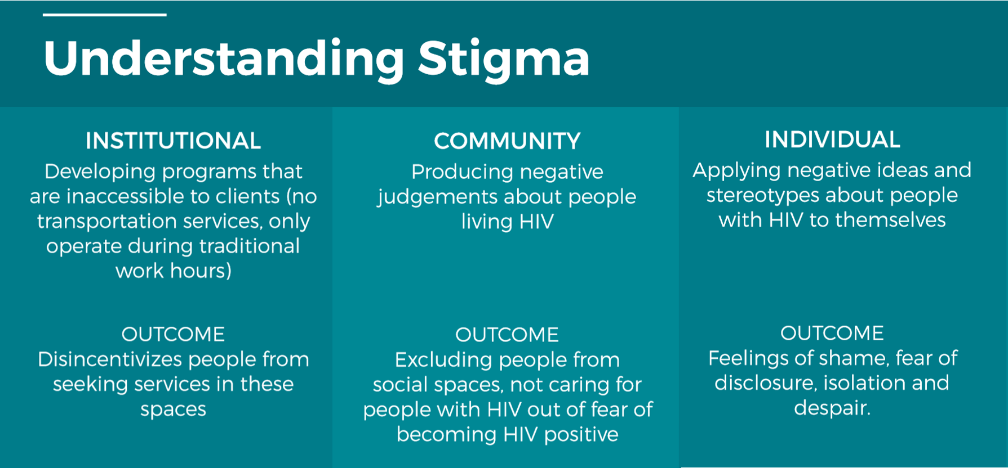
Defining and Understanding Different Levels of Stigma
STIGMA: Negative attitudes/beliefs about a group that differs from a perceived norm
HIV STIGMA: Specific negative attitudes and beliefs about people living with HIV
Notes:
First off, I want to define stigma.
<CLICK>
Stigma refers to negative attitudes or beliefs about a group that differs from a perceived norm, and it leads to the social devaluation of the people who differ from said norm. Stigma can be based on demographic factors such as age, race or ethnicity, gender, sexual orientation, and other identities.
HIV stigma is specific negative attitudes and beliefs about people living with HIV. For those familiar with the HIV Care Continuum/Treatment Cascade, NASTAD often refers to Stigma as the “bar before the bars,” as it remains a major and persistent fundamental social cause associated with health inequity over time, regardless of risk factors or health interventions. Stigma can lead people to avoid accessing HIV testing or treatment and being fearful of disclosing their status to partners, family, and friends.
<CLICK>
HIV stigma operates at different levels and often impacts individuals at ALL levels concurrently
Institutional stigma shows up in laws, policies, and procedures that prevent stigmatized groups from accessing services, and this leads to health inequities. For people seeking health care services, the experience they have going into a provider’s office and the environment there can determine whether or not they return and continue engaging in HIV care.
Community level stigma refers to the sets of beliefs, stereotypes, and prejudices against an individual or groups of people based on a characteristic like HIV status, sexual orientation, race/ethnicity, gender, or the language they speak.
Individual stigma is internalized stigma, meaning when people start to believe the negative things they hear about themselves and reflect that back on themselves. This has negative mental health implications and can make people feel isolated or fearful within their communities.

Slide 154
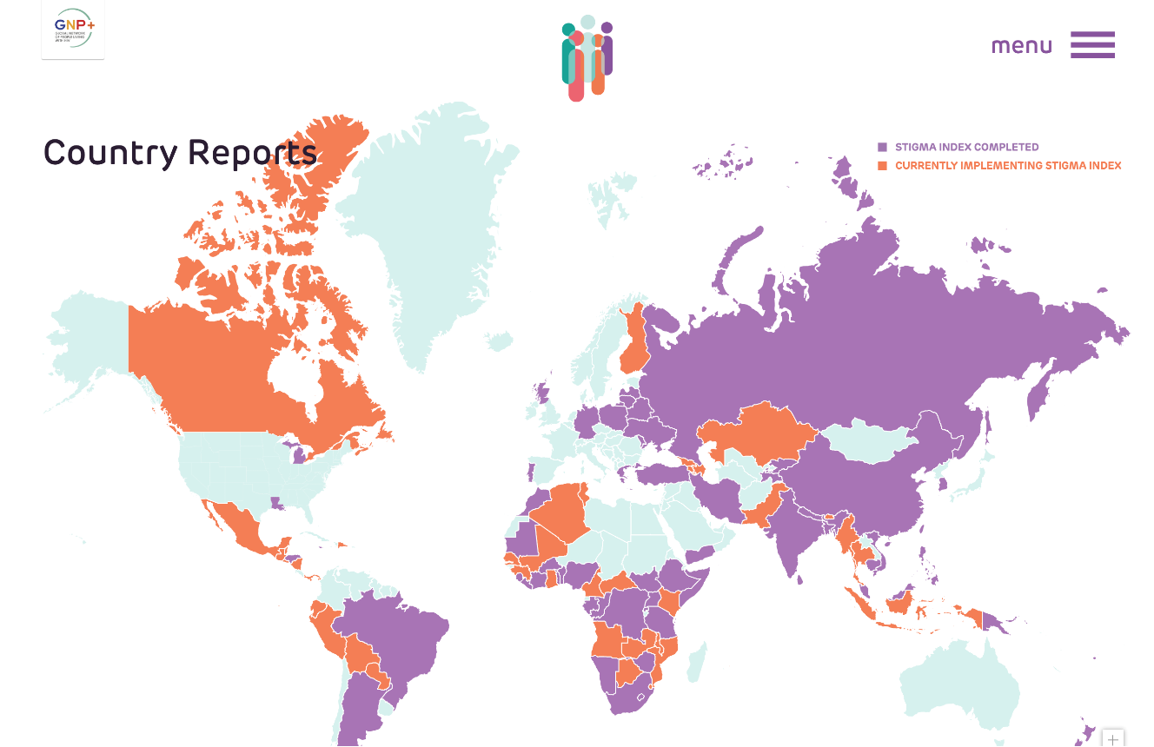
THE EXPERIENCE OF STIGMA: The Stigma Index
Examples from Louisiana report
(https://www.stigmaindex.org/country-reports/#/m/US-LA)
The most common stigma experiences were being gossiped about followed by being verbally insulted/harassed/threatened
Participants experienced layered stigma
Main reasons for experienced stigma/discrimination were related to misunderstandings of HIV, shame, and fear of HIV being contagious
The greatest amount of support was provided by social/healthcare workers and other persons living with HIV, but they were also the same groups that inflicted stigma/discrimination
Notes:
In terms of measuring stigma’s impact, the People Living with HIV (PLHIV) Stigma Index is a standardized tool used to gather evidence on how stigma and discrimination impact the lives of people living with HIV. The Index was developed to be used by and for people living with HIV and was created to reflect and support the Greater or Meaningful Involvement of People living with HIV (GIPA or MIPA) principle, by empowering PLHIV to lead the whole implementation of the PLHIV Stigma Index study. It has been implemented in 100+ countries, and in 3 states – NJ, LA, and MI – in the US.
The Louisiana Stigma Index found that [read bullet points]
<CLICK>
The most common stigma experiences were being gossiped about followed by being verbally insulted/harassed/threatened
<CLICK>
Participants experienced layered stigma, meaning – stigma tied to HIV status, sexual orientation, and other behaviors/experiences
<CLICK>
Main reasons for experienced stigma/discrimination, if known, were related to misunderstandings of HIV, shame, and fear of HIV being contagious (in that order)
<CLICK>
The greatest amount of support was provided by social/healthcare workers and other persons living with HIV, but they were also the same groups that inflicted stigma/discrimination

Slide 155

Cluster Response and Stigma
Be cognizant of using non-stigmatizing, people-first language
“Humanizing” surveillance and HIV-related data – it’s about the people behind the numbers
Calling people “vectors of disease”, for example, can make people feel belittled and seen as public health issues rather than full humans
Notes:
When it comes to HIV cluster response, for structural reasons, it’s common to see an overlap in the individuals most likely to be involved in a cluster AND populations/individuals who face the most stigma and health disparities – whatever health disparities that exist in a community will likely be reflected in cluster detection data too. We talked a lot about community engagement surrounding cluster response in the previous session last week, but it is especially important to be thoughtful about the connection between stigma and language when communicating with people outside the medical community.
Some concrete ways to do this include:
<CLICK>
Being cognizant of using non-stigmatizing, people-first language. Preferred terms can be personal - dependent on the individual/community and can also change over time.
Examples include not using “HIV-infected,” using “commercial sex worker” instead of prostitute, etc., even “cluster” may have a negative connotation and “transmission network” may be preferable to some of your clients/patients
PFL: People-first language puts the “person before a diagnosis/condition rather than asserting what a person “is.” (e.g., person living with HIV vs. HIV-infected person; person experiencing homelessness vs. “homeless people” or “the homeless”)
<CLICK>
Second, humanizing surveillance and HIV-related data is crucial, it’s about the people behind the numbers
It can be easy to reduce people to numbers or systems when talking about data so be intentional about emphasizing individuals, not cases or cluster members
This connects to the last point - being called a “vector of disease” or terms of that sort makes people feel belittled and seen as public health issues rather than humans.

Slide 156
CLUSTER RESPONSE AND STIGMA: People, Not Clusters Article
Important to know why various organizations and individuals object to molecular cluster detection
“…the amplified targeting and stigmatization of our communities, who are already oppressed and marginalized”
Health departments are required to detect and respond to clusters with the CDC funding they receive
Criminalization as the key concern
CDC editorial that discusses the need for reforming and rescinding laws that do not align with science
Guest editorial: We are People, Not Clusters!, Edwin J. Bernard et al., American Journal of Bioethics (2020) | The Center for HIV Law and Policy
CDC editorial: https://www.thelancet.com/journals/lanhiv/article/PIIS2352-3018(20)30333-7/fulltext#%20
Notes:
<CLICK>
On the same vein of humanizing surveillance and HIV data, it is important to know why various organizations and individuals object to molecular cluster detection, sometimes called molecular HIV surveillance by some community members.
There was a guest editorial written in the October 2020 issue of The Journal of Bioethics titled “We Are People, Not Clusters!” This editorial stated that this work “… amplified targeting and stigmatization of our communities, who are already oppressed and marginalized”
It emphasized that the authors do not approve of molecular cluster detection due to the ethical issues it presents and was a response to another article about HIV data justice. They present issues with consent and the potential that these data could show directionality.
HIV criminalization is still a concern in this country, and it impacts communities that are already targeted and stigmatized most based on marginalized identities such as race, sexuality, and gender nonconformity [slow], so it is valid that people might worry about data being used to punish and harm people.
<CLICK>
As mentioned earlier, health departments are required to detect and respond to clusters with the CDC funding they receive but this doesn’t mean that HDs want to do this without community input
<CLICK>
There was an editorial in 2021 from the Director of National Center for HIV/AIDS, Viral Hepatitis, STD, and TB Prevention (Jonathan Mermin) and colleagues that emphasized HIV criminal laws having no impact on decreasing spread of HIV, lacking scientific backing, and pushed for reform related to these laws. If you’re interested in reading these two editorials, they are listed at the bottom of this slide and the links are in the slides you will be receiving.
Next, we will wrap up with a discussion of communication about CDR in terms that do not perpetuate negative ideas about people living with HIV that will make your work more effective, and she will share some general resources on stigma.

Slide 157
Terminology for Community Communications
SCIENTIFIC TERM | LAY AUDIENCE TERM – SOME SUGGESTIONS
Surveillance data | Public health data
Molecular cluster | Group of similar virus strains, Transmission network/ Shared/Growing network
Molecular analysis | Laboratory analysis, analysis of sequence data reported to health departments
Time-space cluster | Increase in diagnoses
Investigation | Public health response, follow-up, Effort to understand why transmission is occurring
Notes:
NOTE: Some of these specific terms came from a survey done in Texas. Jurisdictions can pull from specific research they've done surrounding their community’s preferred terminology or a different trusted resource.
We have heard comments about talking to people “where they are at” and how scientific sounding terms can be alienating or scary for some people. I’m going to go over some suggested language for discussing cluster detection and response work for a non-scientific or lay audience. Preferred terminology also changes over time, and varies by area, even within one state.
<CLICK>
Surveillance data → Public health data
This seems important for audiences who are less familiar with public health since outside of PH the term is also used to describe spying. Within PH this term means collecting population-based data for disease prevention and care
Molecular Cluster
Group of similar or related virus strains; Transmission network/ Shared/Growing network
I wonder if this idea of related viral strains is becoming more mainstream now that phrases like “new strains of the virus” are routinely heard on the news during our current pandemic-soaked reality
Molecular Analysis
Laboratory analysis, analysis of sequence data reported to health departments
Time-space cluster:
Increase in diagnoses, (other ideas?)
Investigation
Public health response, follow-up, Effort to understand why transmission is occurring

Slide 158
Additional Resources on Stigma
WEB RESOURCES
Talking Points: The Resource Guide for Facilitating Stigma Conversations (NASTAD)
HIV Stigma and Discrimination (Avert)
HIV Communication: Using Preferred Language to Reduce Stigma (Sero Project- updated in 2022)
HIV Language Guide (2020, NIAID)
TRAININGS
Undoing Racism (The People’s Institute for Survival and Beyond)
Deconstructing Homophobia and Transphobia (California PTC)
Notes:
These are some additional resources on stigma. The Sero Project and NIAID resources are helpful follow ups to this conversation, and both lay out additional language suggestions and switches to help reduce stigma surrounding HIV. The NASTAD talking points toolkit includes tips for reducing stigma, measuring stigma reduction efforts, and hosting stigma reduction conversations.

Slide 159

Placeholder:
Community Speaker
[insert name, title, bio, etc.]
Notes:
NOTE: NASTAD hosted speakers from the End Stigma End HIV Alliance of San Antonio to discuss their work. We suggest looking up their organization and attempting to find an organization that also works to reduce stigma in your jurisdiction’s local community.

Slide 160
Thank You
FOR QUESTIONS CONTACT
Name
Title
Email
Phone
Notes:
As needed, share information about following up with a PDF/hard copy of slides and/or recording and post-presentation evaluation.
NOTE: The presenting jurisdiction can insert their desired contacts’ information on this slide.

